Slide 1
Basic Legal Search Using Fastcase
By Erin Page
Notes:
Welcome to the Introduction to Fastcase lesson. This lesson is intended to be used to teach legal research students how to use Fastcase at a basic level. Please see (insert name of other lessons)
Please feel free to use this lesson in its entirety, or in pieces as needed to supplement your course. If you have any questions, please feel free to contact Fastcase at 866-773-2782 or at support@fastcase.com. We hope you enjoy this lesson

Slide 2
So what is a database?
A database is a collection of information, with features that allow a user to organize and see connections that would not otherwise be understandable or apparent
Notes:
Examples of legal databases: Fastcase, Lexisnexis, West, Pacer, US GPO

Slide 3
Integrated versus non integrated content
Integrated content is content that is stored within the database.
All content is indexed by the curators of the database.
Content is within the control of the database as to whether it is available to the user or not.
Non-integrated content is content that is linked to a database
Content may be not indexed, or only partially indexed.
Content is maintained by another entity, and therefore access is maintained by another entity.
Notes:
All legal databases, have content that is fully integrated and have at least some content that is not integrated.

Slide 4
What is an Indexed Database?
Indexed Databases
Search based on subject matter or concept
Similar to digest searches.
Information already pre-sorted into categories
For example: you would go to the “Landlords” section for information about landlords.
Downsides:
Multiple editors can lead to inconsistently indexed materials
If the researcher does not locate the correct topic, they will miss vital information
Expensive and time-consuming to maintain

Slide 5
Examples of Indexed Databases
Example on the left: Yahoo in 1998.
Legal examples:
American Law Reports
Keycites
Legal Indexes
Notes:
With a subject-based search, someone else has already categorized the information, which makes it easier to locate the information quickly. On the other hand, you’re relying on someone else’s categorization of the information, which leaves the possibility that it has been categorized in a way different than the way user would have categorized it. It also may become unwieldy the more subjects that need to be categorized. This stuff just doesn’t scale well.
What you’re looking at here is an attempt to take every single webpage in existence in the time and put it in the right place. That works okay when the number of things you have to index is manageable, but what happens when you just can’t hire enough people to do that, or what if it doesn’t make financial sense to do that, because you have millions of webpages popping up every day?

Slide 6
What is a Full-text database
Full-text databases
Search based on individual words
User specifies search terms
For example: type in the word landlord
Benefits:
Ease of use
Searches are not limited to someone else’s categorization
Fast update for immediate accessibility to new materials

Slide 7
Examples of Full-text database
Example on the right: Google, circa 2016
Legal examples:
Fastcase
Public Library of Law
Notes:
Searching a full-text database has the advantage of being both precise and flexible in that the user can search all the data containing the term, and the user not limited to the categorization that someone has put that has put that information in. The user is in control of the search results rather than being stuck with a format someone else decided on.
The downside is that the user might have to do a bit more work to get information — the user can’t just willy-nilly click on links and hope to get lucky. The user needs to enter in a search phrase, which needs to be crafted in order to have precise results.

Slide 8
Natural Language Searching
Natural language searches are searches using regular sentence construction. No specific phrasing or terminology needed.
The search engine then takes that query and uses it to try and figure out exactly what it is you want to find.
Examples:
What is an affidavit?
What is the statute of limitations for assault?
What is the Fourth Amendment?
Benefits:
Easy to construct
Downsides:
By using a natural language search, you are essentially leaving it up to the computer to decide what it thinks is relevant
To achieve a higher level of accuracy, natural language search engines require many questions on the topic. If it is a new concept or infrequently searched, the search is less likely to be accurate.

Slide 9
Sample natural language Search
Notes:
The above search shows a natural language search: a query phrased as if the user was speaking to a colleague. Such searches provide a great overview of the amount of information that might be relevant. However, as noted above, they result in a large number of results, most of which are likely to be too general or inapplicable to any specific case.

Slide 10
History
George Boole (1815-1864): first proponent that logical statements can be expressed using mathematical terms.
Boolean logic is now the basis of modern binary, as well as the most precise system of searching documents (also known as Keyword searching)

Slide 11
Boolean Searching
Uses specific, pre-defined operators to specify which search terms are important and how they should be related.
Examples:
Fire and apprentice
Fraud not criminal
Rule* /5 “803(5)” AND knowledge OR recall NOT memory
Benefits:
High-level precision
Downsides:
Requires consideration as to what terms are important
Requires review of search terms to ensure correct operators are used for the desired relationship of terms.

Slide 12
Sample Boolean search
Notes:
The above search shows a very basic Boolean (Keyword) search. Without using any more precise terms or concepts than was present in the natural language search run earlier, you can see that the simple addition of operators has already eliminated 3/4 of the previous results.

Slide 13
Develop a research strategy
Search Term
Legal Principles
Prior Training and Experience
General Research with a Secondary Source or Natural Language Search
5 W’s
Original Fact Scenario
Narrow Issues
Notes:
A good search starts off with a little planning. Tip 1: Develop a research strategy. A user should do some pre-thinking or strategizing so that the user knows what information they are searching for and doesn’t waste time getting lost on tangents and unrelated issues
How would a user do that? If a user is familiar with the area from prior training or research, they likely know where to begin. If it’s an area of law the user is wholly unfamiliar with, a good starting point is with secondary sources like a bar journal article, law review article, treatise, or maybe even a google search. That gives the user an idea of the big picture. The user could also use a natural language search in caselaw, if they have some idea of what they want but are looking for a case that discusses a lot of black letter law and principles.

Slide 14
5 W’s
What are the facts? Are there any facts that would make my search special?
Notes:
Once a user have done a little brainstorming and received some general information from a secondary source or natural language search, the user is ready to start narrowing the focus. A good tool are the Five Ws people often talk about in the context of journalism – who, what, when, where, and why. Depending on the fact pattern, each of these may give the user useful keywords to use in the search.

Slide 15
Legal Principles
A fact scenario will frequently bring to mind specific legal terms. Using those legal terms will increase the likelihood of a successful search as they are terms that the courts use when delivering their speech.
On the left is an example of the tag cloud from Fastcase 7, which provides terms that are commonly associated with your search so that you can narrow your search further.
Notes:
How does a court speak about the issues? Is there specific language or terms that the court is more likely to use? Do the facts remind you of a well known case? How did that well known case speak of the issue?

Slide 16
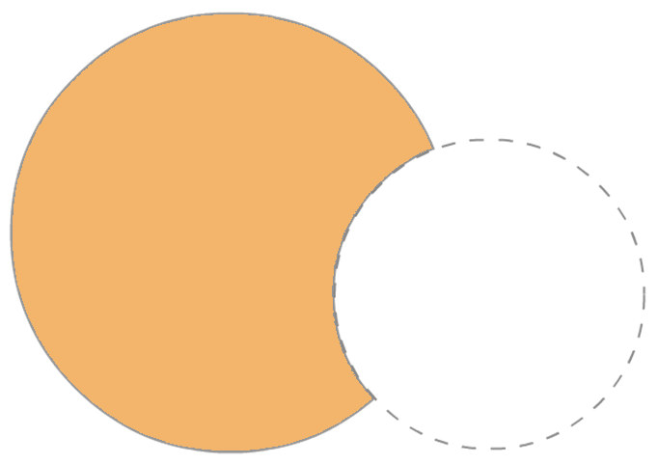
Narrowing your search
speech NOT school
Even a well thought out search will have extraneous cases that are not relevant to your fact pattern. The addition of a “not” term or other restriction can make a search more focused and likely to produce the desired results without having to wade through extraneous responses.
Speech
School
Notes:
Examples of restrictions: only federal law, only Texas cases, only cases from 2005 onward, cases that do not include “civil”, cases that have the search terms in proximity.

Slide 17
Fastcase Boolean operators
Operator | Example | Description
AND, & | libel AND damages | Results must contain both “libel” and “damages”
OR | premarital OR prenuptial | Results must contain either “premarital” or “prenuptial”
NOT | negligence NOT criminal | Results must contain “negligence” but not the word “criminal”
w/3, /3 | custody /15 interrogation | Results must contain “custody” w/in 15 words of “interrogation.”
*, ! | testif* | Results must contain some variation of the stem “testif” such as testified, testify, testifying, etc.
? | mari?uana | Results must contain m-a-r-i-_-u-a-n-a with any letter substituted for the question mark
“ ” | “estate tax” | Results must contain the exact phrase “estate tax”
( ) | (confront OR cross-examine) | Parentheses tells Fastcase to do the operations contained within it before doing things outside
Notes:
Examples of Boolean connectors. For full information on Boolean Searching, please see the Boolean search lesson.

Slide 18
Searching materials other than case law
Unlike caselaw, statutes and regulations are likely to be created and organized in a logical manner. Statutes involving real property are likely to in the same title. Regulations involving zoning are like to be in the same section.
Instead of searching with a generic term, it can be easier and more effective to browse for the materials. Fastcase and other databases frequently maintain an index of statutes, regulations, court rules and other materials, which can be browsed through in order.
Notes:
Browsing a statute can also be convenient if you need to see a statute in its original context, or if you need to review/ print several statutes.

Slide 19
Statutes as starting places for research
Annotated statutes can also be a valuable starting place for further research. On the left, you see Wis. Stat. Sec. 968.22 Effect of technical irregularities. (Wisconsin Statutes (2015 Edition)). This statute includes an annotation to the Wisconsin Constitution regarding the topic of search warrants and cars.
Notes:
Additional information that may be in the annotations at the end of a legal document: effective dates, citing caselaw, controlling regulation, notable secondary sources on the topic, ethical rules, etc.

Slide 20
Search process
Identify concepts / terms
Craft a search
Review results
Refine search
Identify issue
A good search is like a dance — general steps you follow with added flourish to impress people
Legal Research Dance
Notes:
The process of turning a concept into a search is a sort of dance. It involves an informed stab in the dark to create search terms based on your issue, and then examining the results to refine the search. The user repeats this process until satisfied with the results.

