Slide 1
Teaching Boolean Using Fastcase

Slide 2
Boolean Searching
Uses specific, pre-defined operators to specify which search terms are important and how they should be related.
Examples:
Fire and apprentice
Fraud not criminal
Rule* /5 “803(5)” AND knowledge OR recall NOT memory
Benefits:
High-level precision
Downsides:
Requires consideration as to what terms are important
Requires review of search terms to ensure correct operators are used for the desired relationship of terms.
Notes:
When a user is performing electronic legal research, usually the user is looking for a concept and not a particular phrase or word. However there is no requirement that a Judge, legislator, or other writer of legal documents use the specific phrasing for a concept that you are expecting. Many electronic databases, including Fastcase, are full-text databases, which are based on words and not concepts. This is why sometimes it takes practice to be able to translate concepts into effective search term.

Slide 3
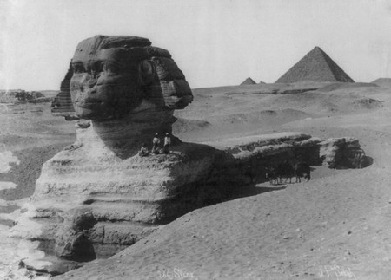
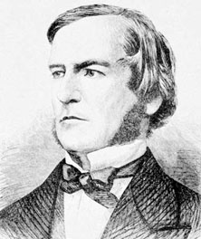
A BIT OF History
Formal logics were initially developed in ancient times in Ancient Egypt, China, & India.
George Boole (1815-1864): first recorded modern proponent of using logical statements to express mathematical terms.
Boolean logic is now the basis of modern binary, as well as the most precise system of searching documents (also known as Keyword searching)
Notes:
Boolean is logic, although the concept of “logic” originally started out in ancient Egypt, it has been refined in modern times.
Boolean sounds like a funny word, however, it stems from the name of the person who we can identify and give credit to. That person is George Boole, he was an English mathematician, educator, philosopher and logician. He is credited with bringing light to the logic that helped lay the foundation for the “Information Age.”

Slide 4
Two things to keep in mind
Synonymy
Words that can mean the same thing
Use synonyms for better results
Ambiguity
Words that can mean more than one thing
Avoid ambiguity by adding terms or the “not” operator
Ex. Car, vehicle, truck, van, automobile
Ex: Negligence not criminal
Notes:
Two things to keep in mind before start constructing a search are Synonymy and Ambiguity.
Synonymy – that’s multiple words that express the same concept. Therefore, when a user is running a search, the user should try to think of synonyms or other words that might be used to describe the same thing. One example would be if the user was searching for a case involving a gun. The user could choose car as a keyword but might want to include the word automobile, because that means the same thing and an opinion might use the term automobile rather than gun.
On the other hand, watch out for ambiguity, when a set of words can express more than one concept. There are ways to deal with ambiguity that’s inherent in language itself, such as by adding more search terms to eliminate false positives or irrelevant search results. One example of a word that could be used in two different ways is the word negligence in an injury case. There can be both criminal and tortious negligence, so the user might want to add more keywords to eliminate the criminal negligence cases if the user is only searching for tort-related negligence cases.

Slide 5
Fastcase Boolean operators
Operator | Example | Description
AND, & | libel AND damages | Results must contain both “libel” and “damages”
OR | premarital OR prenuptial | Results must contain either “premarital” or “prenuptial”
NOT | negligence NOT criminal | Results must contain “negligence” but not the word “criminal”
w/3, /3 | custody /15 interrogation | Results must contain “custody” w/in 15 words of “interrogation.”
*, ! | testif* | Results must contain some variation of the stem “testif” such as testified, testify, testifying, etc.
? | mari?uana | Results must contain m-a-r-i-_-u-a-n-a with any letter substituted for the question mark
“ ” | “estate tax” | Results must contain the exact phrase “estate tax”
( ) | (confront OR cross-examine) | Parentheses tells Fastcase to do the operations contained within it before doing things outside
Notes:
The heart of what makes Boolean Keyword searching different from Natural Language and Index searches is the use of Boolean operators. So what is a Boolean operator?
Operators are commands that tell the search engine what to do, or what operation to perform, with the keywords. For example, a plus sign – that’s an operator in mathematics. It tells the reader to take the first number, add it to a second number, and arrive at the sum of two numbers.
A Boolean search is really just something that tells the reader if something is true or false. So in the simplest terms, Boolean operators say “hey look at these rules I’ve given you: If they equal true – meaning the case has all the stuff I say I want and none of the stuff I say I don’t want – then let me see it.”

Slide 6
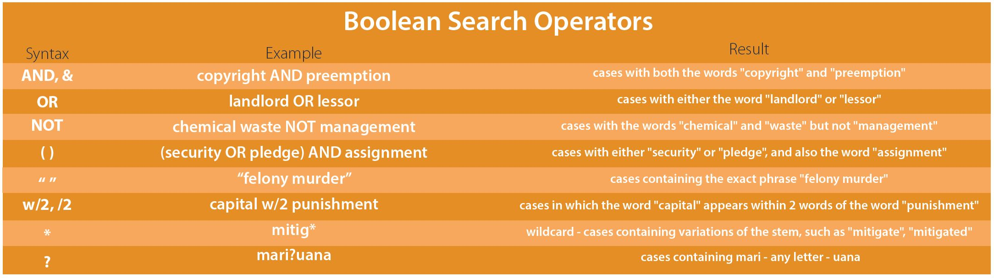
Boolean Search Operators
Notes:
The operators are conveniently explained and demonstrated on the actual Fastcase “Advanced Caselaw Search” page. Under “Show Search Tips” one sees all of the operators and there are brief explanations of what the actual operator does.

Slide 7
AND — dog AND bite
Dog
Bite
Only returns cases at the intersection — ones containing both the words “right” and “wrong.”
Dog & bite
Notes:
Here the search is libel AND damages (or in this case “Dog & Bite”). Some cases in the database will say the word libel. Others will say the word damages. A certain percentage (probably not all) will use both those terms in the opinion. Using the AND operator tells the search engine to only give the user cases in that intersection.

Slide 8
OR — car OR automobile
car OR vehicle
Returns all cases around the perimeter of the two words — either those using the word “car” or the word “automobile.”
Car
.Vehicle
Car
&
Vehicle
Notes:
Use the OR to construct a broader search. An OR operator tells the search engine (Fastcase) that the user don’t care which of these words a case uses as long as it uses one of them.
In the example above: the user is looking for all cases containing one of the words “car” or “vehicle”. It doesn’t matter which term is used, but one must be present in order for the search engine to provide the case.
The OR operator is really useful for synonyms. This way the user can run a search looking for multiple terms that have the same or similar meaning without running several searches.
Additionally, the user can efficiently use the OR operator a lot when not certain how a court would cite a particular rule. For example, if looking for cases referencing a rule of civil procedure, the user can try to anticipate all the ways a court could possibly cite to the rule and throw them in a big OR statement. For example: FRCP 1 OR Fed R. Civ P. 1 OR Federal Rules of Civil Procedure 1.

Slide 9
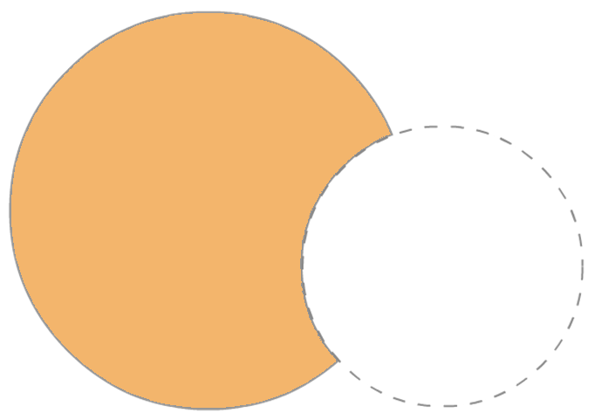
NOT — speech NOT school
speech NOT school
Only returns cases mentioning “speech” without referencing the word “school.”
Speech
School
Notes:
The NOT operator tells the search engine that the user doesn’t want cases with the word or words that follow it.
For instance, let’s say the user wanted cases relating to limitations on speech. The user may already be familiar with the subject area and know that there are a lot of instances where speech is limited in schools. If the user does not need school speech examples, try limiting my search by searching for: speech NOT school
Be careful here. Because the “not” operator excludes cases with any appearance of whatever word (or words) specified, it may be that the word was mentioned once in a tiny footnote and the case that was otherwise relevant was just eliminated.
One tip is – in the NOT portion of your search, try pairing that to the main concept with a proximity operator. In this instance I might search for something like: speech not (school /5 speech). That way the user can be sure of not getting rid of cases only passingly mentioning the word school.

Slide 10
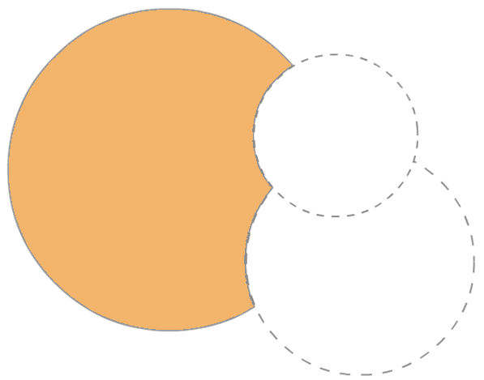
speech NOT (school OR political)
speech NOT (school OR political)
school OR political
Political
Speech
School
Only returns cases mentioning “speech,” but not mentioning “school” or “political.”
Notes:
Multiple operators are necessary for truly precise search phrases. It’s important to remember what the goal is of the user search and to ensure that your search is punctuated appropriately.
Above is the search for speech NOT (school OR political). In other terms, the user wants cases about speech, but does not need cases about political or school speech.

Slide 11
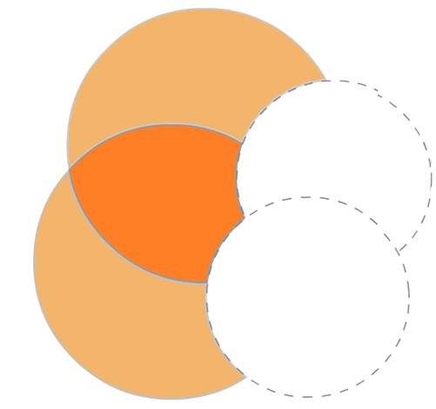
speech AND public NOT (school OR political)
(speech AND public) NOT (school OR political)
Speech
Political
The cases returned will use both the words “speech” and “public” but won’t use either the words “political” or “school.”
“X”
School
Public
school OR political
Notes:
As seen above, the search can get increasingly more complex depending on the number of terms added. Please also not the punctuation of the search (speech and public) NOT (school or political).

Slide 12
Proximity or within — w/# or /#
custody w/5 interrogation — return cases where custody appears within 5 words of interrogation
Sample matches:
in-custody interrogation of a suspect . . . . (w/1 matches.)
unless in-custody police interrogation is . . . . (w/2 matches.)
interrogation while in custody may give . . . . (w/3 matches.)
custody for purposes of interrogation . . . . (w/4 matches.)
Notes:
The within or proximity operator restricts results to phrases that appear within a certain distance of the other search term . For Fastcase, the user can form the operator by using a forward slash and then a number, or by entering a w, then a forward slash and then a number. The number indicates the number of words (inclusive) between the first term and the second term. Some search engines also permit you to indicate a search within a number of sentences, or within a number of paragraphs. However, that method tends to be fairly imprecise due to different definitions of sentences and paragraphs. Fastcase specifically uses within number of words.
Why is proximity searching useful?. What are the chances a user knows *exactly* how a court is going to phrase something within an opinion? Sometimes there are terms of art, for example “right to privacy”. The user can be fairly certain it is almost always going to be phrased that way. But what about a reference to a certain rule? The court may say something like “Rule 12(b) of the Federal Rules of Civil Procedure” or it might say “Federal Rule of Civil Procedure 16.” The user can capture any variation of those citations by looking for cases where the number 16 appears in close proximity to a court mentioning the FRCP.
It’s not just useful in the context of rules either. In the example above, a user is looking for cases dealing with custodial interrogation. There could be any number of ways a court could phrase this, but more than likely it’s going to use the words custody and interrogation pretty closely in the same opinion. This search will return all those cases mentioning custody and interrogation within 5 words of each other.

Slide 13
“Quotation marks”
Sample matches:
. . . that the communications privilege encompassed within the same statute precludes . . .
. . . marital communications privilege is not applicable here because Mr. and Mrs. Irons were estranged at the time of the conversations.
Not in search results:
. . . spouse may enjoy marital privileges from . . .
. . . the marital communications privilege may be waived . . .
“communications privilege” — returns only cases with that exact phrase
Notes:
Sometimes the user /does/ know exactly how a court is going to talk about a specific legal concept. In that relatively rare instance, the user should always use the quotation operator.
In the above example, the user is looking for cases involving a privilege in the context of a marriage. Searching for “marital privilege” in quotes tells the search engine the user only wants to see cases where the phrase “marital privilege” is used with those exact words in exactly that order with nothing in between them. Make careful note of the possibly relevant responses on the bottom that would be excluded from the search is the term is in quotation marks.
Other examples might be “eminent domain,” “motion to compel,” “estate tax,” or “summary judgment”.

Slide 14
General Note on The Plural Form
Remember to include your Plurals
Full text search engines do not automatically look for plurals in Boolean searches
If you want to include plurals, you have to tell the engine to look for them by using a wildcard or root expander
Notes:
Full text search engines, including Fastcase, do NOT automatically search for plurals when the user is using a Boolean search. Some, including Fastcase, DO look for plurals when the user is running a natural language search. Based on that, please be aware that the search engines don’t search for past tense or future tense automatically either. Search engines just look for the exact word the user enters by default.

Slide 15
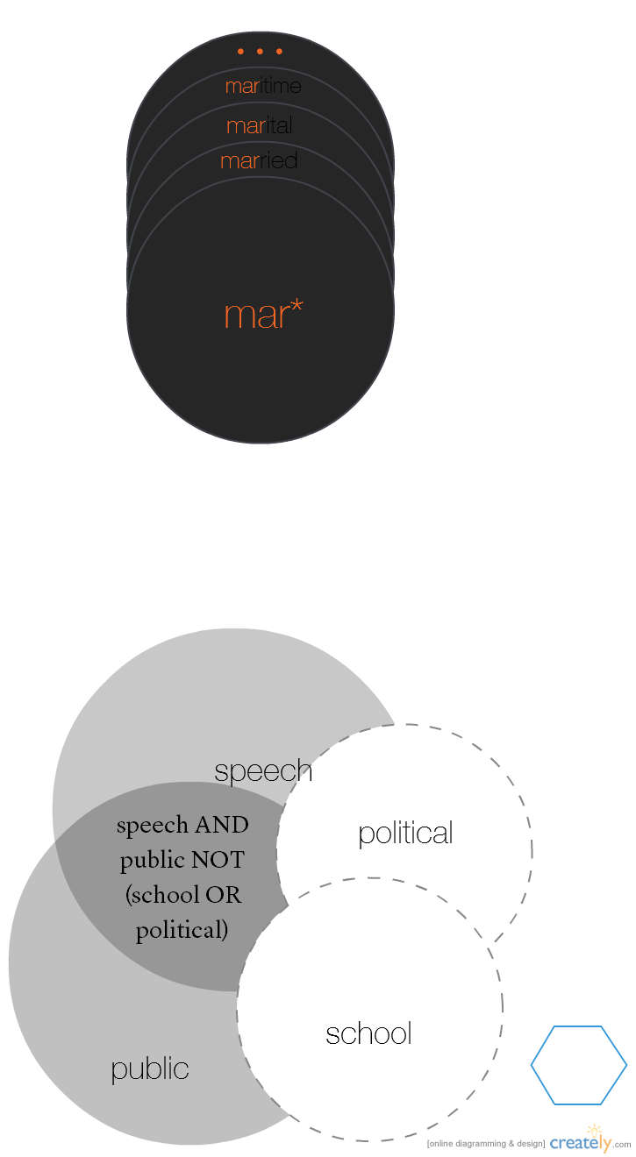
Root expander (*, !) — mar*
Return cases with at least one word that begins with “mar.”
Pros:
Useful for plurals, different tenses, gerunds, etc.
Cons:
Can slow down search times – if you just want to search plurals, OR is faster
Can be over-inclusive — see, e.g., maritime in this search.
Notes:
The asterisk or exclamation point is the root expander operator. This tells the search engine to start with the base of the word and return cases including words that have that base.
In the previous example, recall that the user was looking for marital communications privilege. The search we used was “marital privilege”. That’s good, but what if a court references “marriage privilege” and not “marital privilege.” The user can capture both of these possibilities by searching for mar* /5 privilege. The user should always think about the different ways a word could be used and start as far back in the word as possible before inserting an asterisk.
Protip: users may see some searches that end in an exclamation point – that’s just another way to write the root expander.

Slide 16
Order of Operations
W/5
The “Within” operator runs first
AND
The “And” operator is run second
The “Exclude” operator runs third
NOT
OR
The “Or” operator runs last
Notes:
To help construct better searches users have to be generally aware of the order of operations. Fastcase’s search engine will look at the operators used and perform certain ones first. If the search contains a “within” operator, it will perform that using the words on either side of the within, then the words connected by AND operators, then those with OR or NOT. To change that order, the user can do so using parentheses.

Slide 17
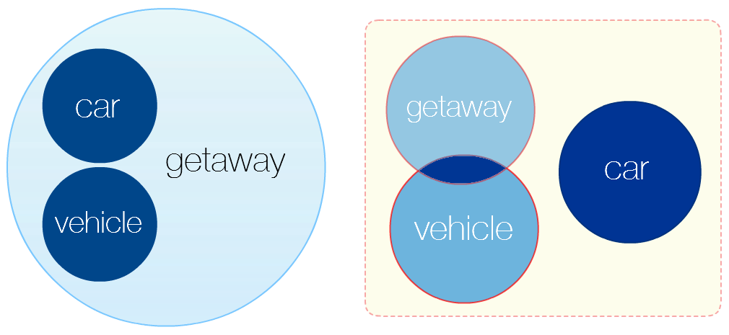
Parentheses — what happens when the user does not use it
What the user entered:
car OR vehicle AND getaway
What the Search actually saw: car OR vehicle AND getaway
Notes:
Search Engines, including Fastcase have to try to interpret what the user means based on the text put into the search. That means it has to have rules about in the order in which it should interpret those operators. Those are called the order of operations.
Similar to the Order of Operations from elementary school math – where there is an equation and the reader needs to know that division and multiplication should be done before addition and subtraction. Just as in those elementary school examples when you put those numbers in parentheses, you do those operations first. Fastcase works the same way — things in parentheses are done first.
Why does that matter? Well, take the search here: car OR vehicle AND getaway.
All ANDs are actually done first in Fastcase, before the ORs are done.
So in the venn diagram above on the left, that’s what the user is actually be looking for in this search – the subset of cases that use the word getaway, but in addition to that also uses the word “car or vehicle”. In the venn diagram above on the right, that’s what the search engine sees- the subset of cases that use the word car or cases that include “getaway and vehicle”. This is pretty much the opposite of the result the user was expecting.

Slide 18
Subtle but important distinction
Correct:
(car OR vehicle) AND getaway
Incorrect:
car OR (vehicle AND getaway)
Notes:
Here’s what these two searches look like graphically side by side. The one the user actually wants on the left vs. the on the user will actually get (if there are no parentheses) on the right.

Slide 19
Advanced Order of Operations
Consider the following searches:
Rule* /5 “803(5)” AND knowledge OR recall NOT memory
knowledge OR recall NOT memory AND Rule* /5 “803(5)”
Rule* /5 “803(5)” AND (knowledge OR recall) NOT memory
A:
B:
C:
A (wrong): 157,342 results; B (wrong): 1,038,488 results; C (right): 99 results
Notes:
Let’s say the user wants the FRE 803(5)(C) or (A) rule discussing how a recorded recollection must accurately reflect the witness’s knowledge. But the user is explicitly not interested in subsection (B) talking about accurate adoption when it was fresh in her memory.
The slide shows three examples of how a user could write a search with all these terms.
If the user ran the “a” search in fastcase, it would result in 157,342 results because the search engine will perform with “/” within operator first, then the “and“ operator, then the “or” operator, then the “not” operator. This means that the search results will include a large set of “recall” results without performing the other restrictions the user was intending.
If the user ran the “b” search in Fastcase, it would result in 1,038,488 results because the search engine will perform the “/” search first, then the “and“ operator, then the “or” operator, then the “not” operator. This means that the search will include a large set of “knowledge results without performing the other restrictions the user was intending.
If the user rant the “c” search in Fastcase, it would result in 99 results because the search engine will perform the “/” search first, then the “and“ operator, then the “or” operator, then the “not” operator.

Slide 20
Concept |  | Keyword and operator
Testimonial privilege | → | (testimon* or marital) /3 privileg* AND
Communications privilege
Compelled testimony | → | (compel* or requir*) /5 testif* AND
Spouse | → | (spous* or husband or wife)
Criminal trial | → | NOT civil
Notes:
Sample breakdown of the previous example regarding marital privilege.

Slide 21
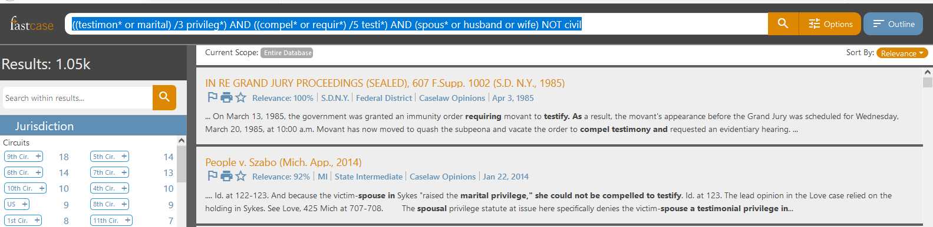
((testimon* or marital) /3 privileg*) AND ((compel* or requir*) /5 testi*) AND (spous* or husband or wife) NOT civil
Notes:
(testimon* or marital) /3 privileg* AND (compel* or requir*) /5 testi* AND (spous* or husband or wife) AND NOT civil – a view of how this will look once entered into the search box.

