Slide 1
Introduction to Fastcase
By Erin Page
Notes:
Welcome to the Introduction to Fastcase lesson. This lesson is intended to be used to teach legal research students how to use Fastcase at a basic level. Please see (insert name of other lessons)
Please feel free to use this lesson in its entirety, or in pieces as needed to supplement your course. If you have any questions, please feel free to contact Fastcase at 866-773-2782 or at support@fastcase.com. We hope you enjoy this lesson.

Slide 2
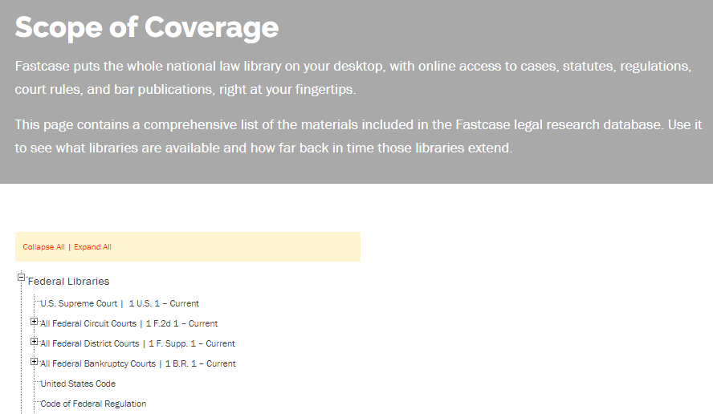
Scope
Primary Law:
Cases
Statutes
Regulations
Court Rules
Constitutions
Secondary Law:
HeinOnline Partnership
Treatises
CLE Books
More…..
Not sure? Check our Scope of Coverage page:
fastcase.com/coverage
Notes:
Fastcase is an expanding database. The database started with caselaw and has expanded to statutes, regulations, court rules, constitutions, and other legal documents. An important part of legal research is to ensure that the database you are using contains the materials you are looking for. If you are looking for secondary sources, Fastcase has a partnership with HeinOnline, and also offers treatises, CLE books, and journals directly.

Slide 3
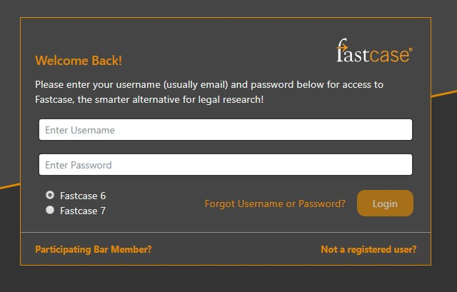
Logging In
Go to www.fastcase.com/login. Enter your email address and password.
Did you know you can download the Fastcase app for free and use it for free for your entire career? Available for Android and iPhone.
Notes:
Logging in is simple and all users of Fastcase have access to the major features. If a user is a member of a bar association that offers Fastcase as a member benefit, they would click on the “Participating Bar Member?” link. Otherwise, everyone logs in from the same place.

Slide 4
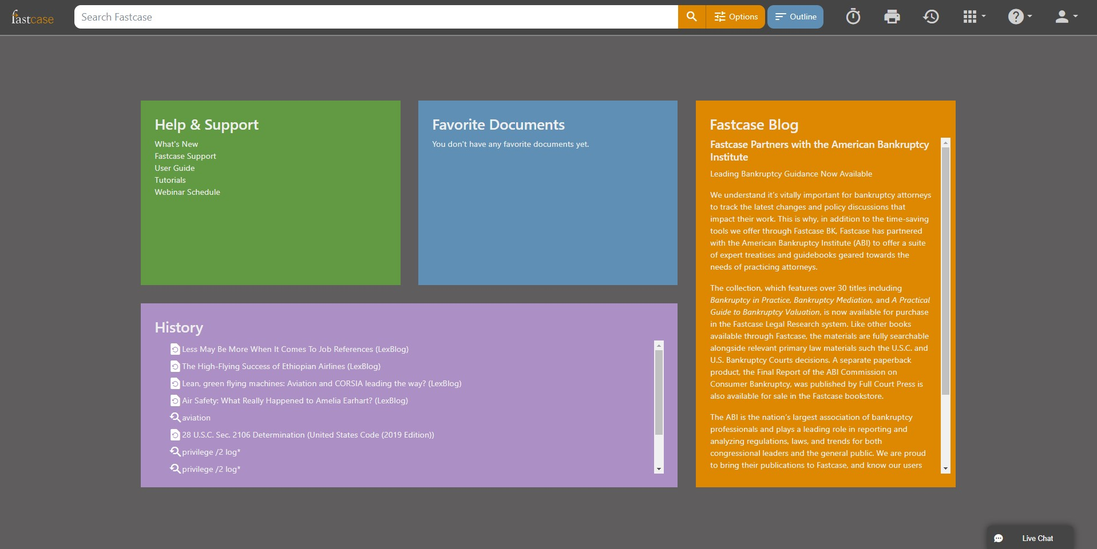
Homepage
Notes:
The homepage is accessible at any time by clicking on the “fastcase” logo at the top left of the screen. At the top right of the screen, you can see a person icon. To access the settings for your account, simply click on the person.
The quick search is located at the top center of the page. Best used for a generalized search, with no content restrictions.
To the right of the quick search bar is the “Options” link. Best used for precision searching, including limitations of date span, jurisdiction, and other modifications. See the advanced search slide.
Help & Support: quick links to our user guide, live chat with a trained reference attorney, video tutorials on using Fastcase, and a schedule of free webinars on legal research hosted by Fastcase.
Search History: Shows most recent searches automatically for easy reuse.
Favorite Documents: Shows links to your favorite documents
Blog: see articles of interest on our blog, including search tips, new features, and general news of interest for Fastcase.

Slide 5
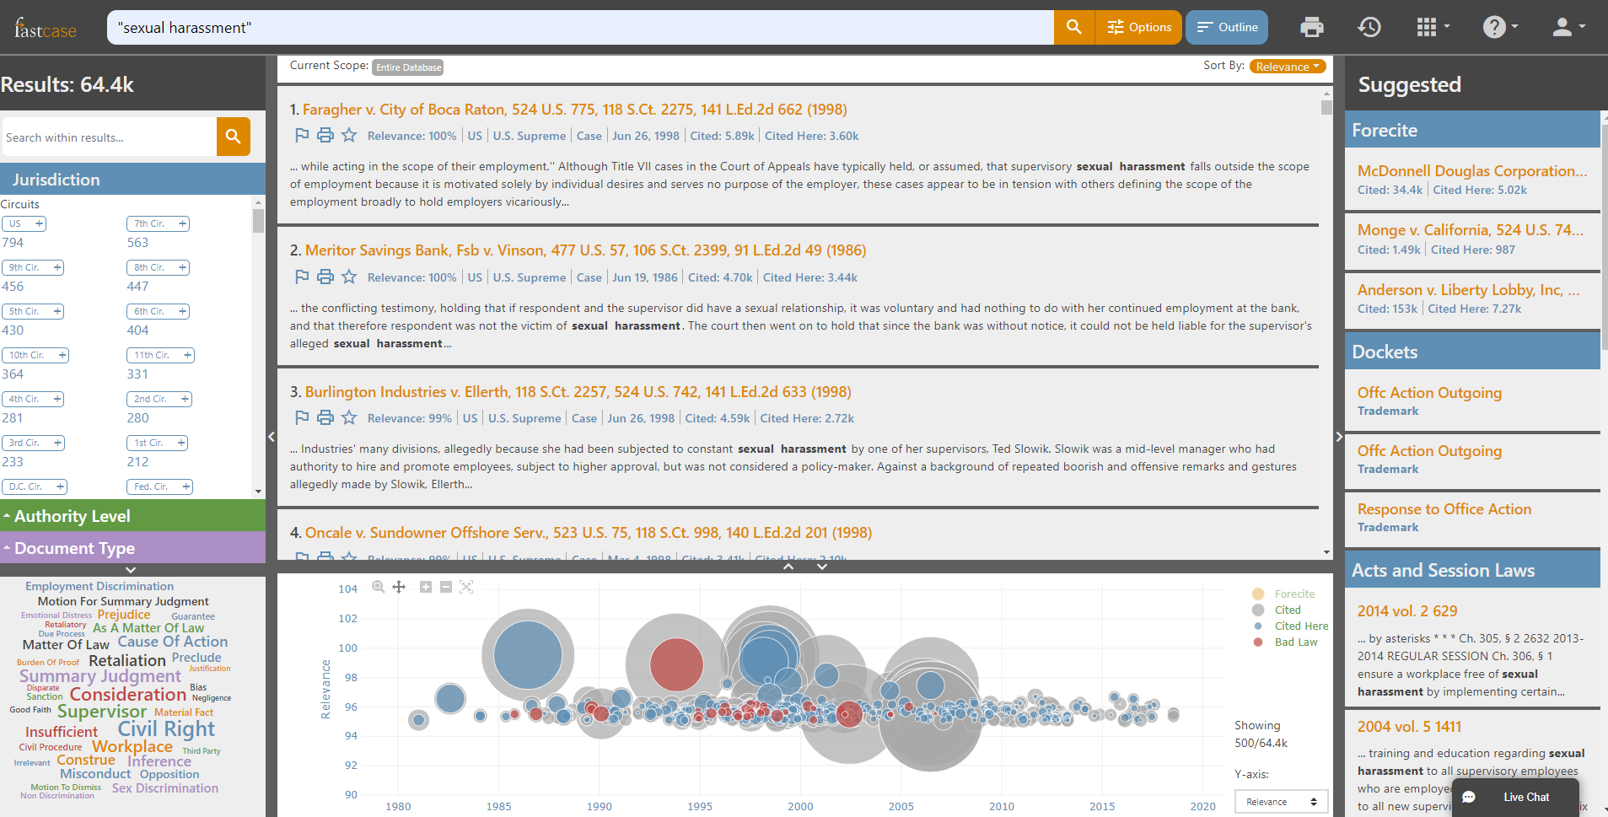
Results
Notes:
Search results are “bottomless” with no need to click “next page”. Start scrolling, keep on scrolling, same page.
Search results are automatically sorted by “relevance” to your search terms. However, the cases can be resorted by date or by number of citations in the database by clicking on Sort By in the upper right corner of the search results box.
On the right side of your results screen is Forecite. See the next slide
On the left side of your results screen is Search within. See slide 7
For the items at the bottom of the results page, see slide 8

Slide 6
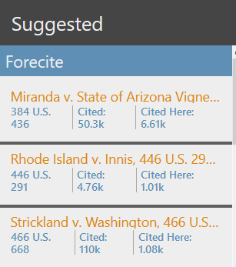
Forecite
Notes:
On the right side of your results screen is Forecite. Forecite locates cases that are related to your search, but do not have your exact search term. Great for locating seminal cases that use synonyms for your search terms.

Slide 7
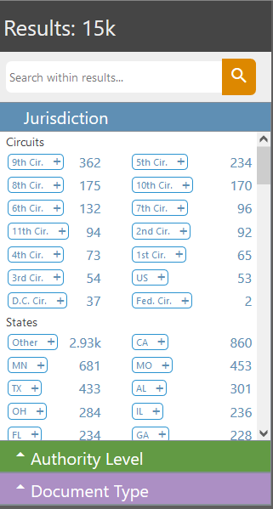
Search within
Focus your search with ease. On the left side of your results page, you can narrow your search by narrowing the jurisdiction, document type, and court level with a click of the button.
Notes:
If a user ran a general search, then realized that they wanted case law, they can access that material by clicking on Document Type and “Cases” filter on the left. Users can also focus a search by selecting a level of court, or a specific jurisdiction. Additionally, a user can enter a freehand filter by typing in the search within box at the top of the pane.

Slide 8
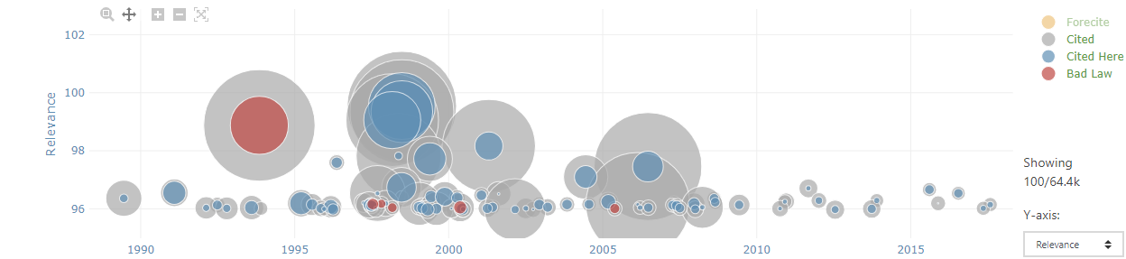
Interactive Timeline
Notes:
The interactive timeline appears at the bottom of the results page, allowing you to see which cases in your search have been cited the most and gauge the relevance of each case immediately.

Slide 9
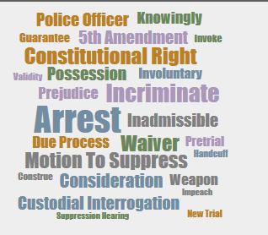
Tag Cloud
Notes:
On the bottom left of your results screen is a semantic tag cloud, which allows you to see common search terms that are located within your current search in order to further refine your search if needed. Simply click on the term to add it as a filter, similar to adding a freehand filter to your search using “Search Within”.

Slide 10
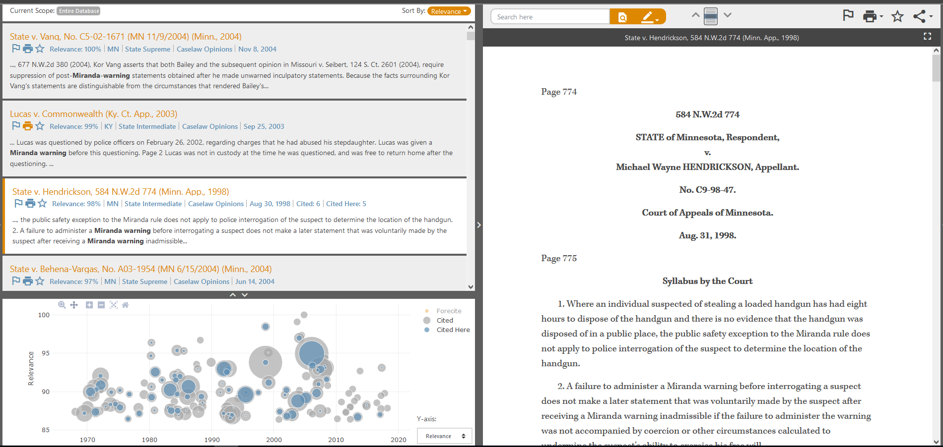
Navigating A Document
Notes:
Search results remain on the left side of the screen, which allows users to easily navigate to other cases in the results list.
See your case’s relevance immediately with the interactive timeline, also remaining on the left side of the screen.
Links to bad law bot (see bad law bot slide), highlighting (see high-lighting slide), and printing (see printing slide) at the top of every page.

Slide 11
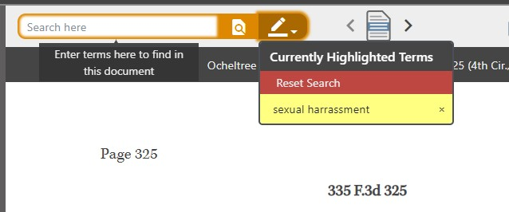
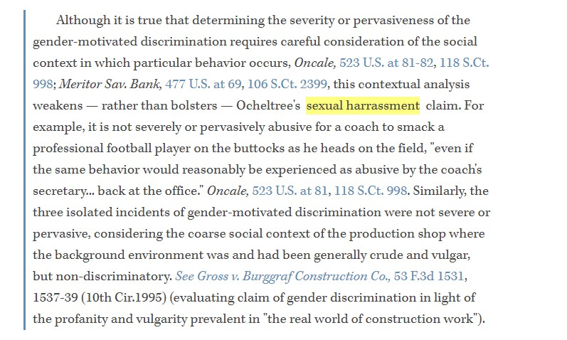
Highlighted Terms Searching Within A Document
Notes:
Documents will automatically have the search terms used to find them highlighted. Entering a new term into the “search here” box will highlight that new term as well. You can jump from term to term or directly to the most relevant paragraph button by using the arrows on the right.

Slide 12
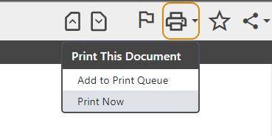
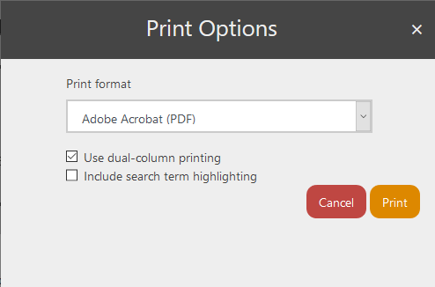
Printing
Notes:
Fastcase doesn’t charge to print, save, or email, so users can feel free to save as many cases as needed. To print, click on the “print” icon.
Print options including printing with the highlighted search terms, printing with one or two columns, and printing in Word, RTF, or PDF formats. Fastcase does not print directly, so users can elect to maintain a digital copy, or print from the word processor or PDF program.
If you select yes for highlight search terms, the search terms used to locate the document will remain highlighted in the downloaded version.

Slide 13
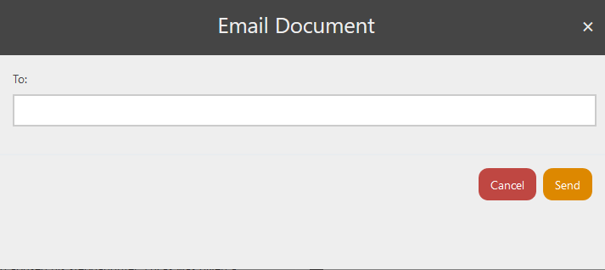
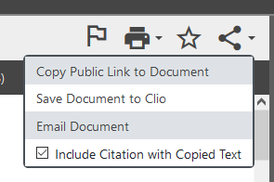
Emailing
Notes:
Cases can be emailed to a colleague by clicking on the email link.

Slide 14
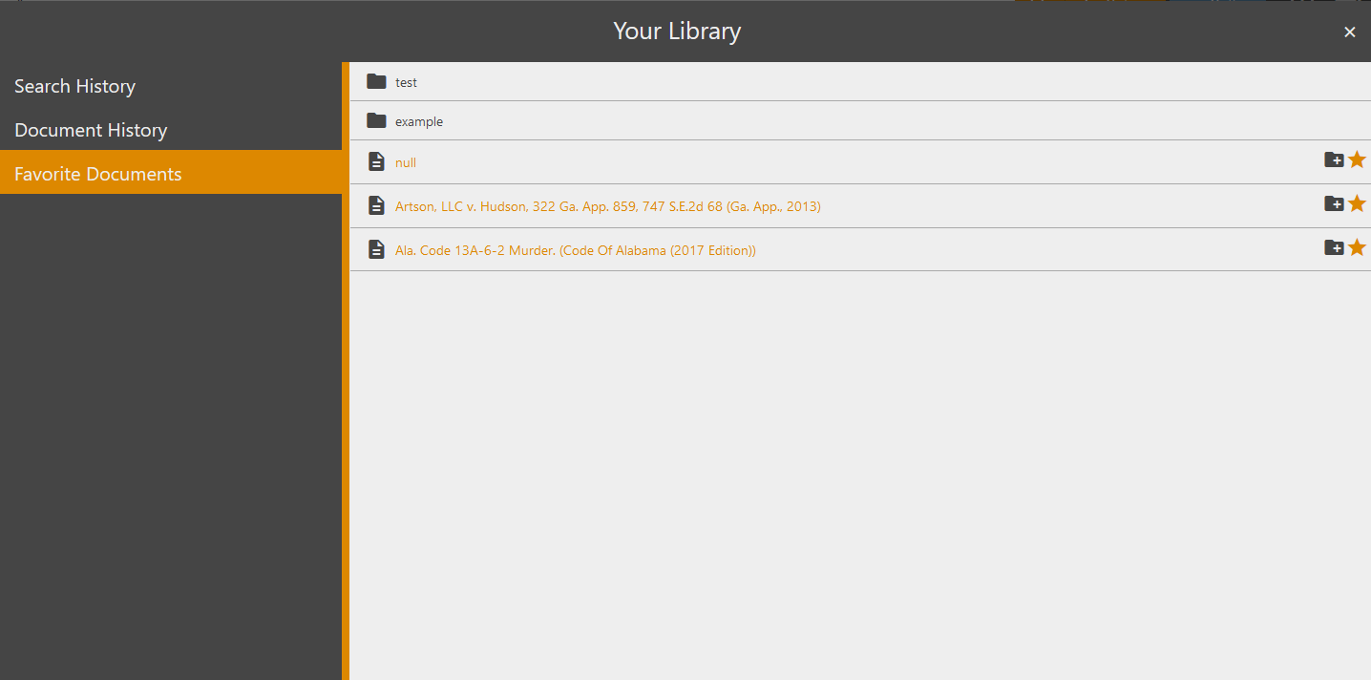

Favorites
Notes:
Adding a document to favorites allows you to easily find documents later. Click on the star to add a document to your favorites. When the star turns orange the document has been added to your favorites to view later. If you have many favorites, you can organize your favorites in folders, similar to bookmarks in your internet browser.

Slide 15
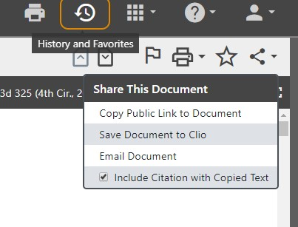
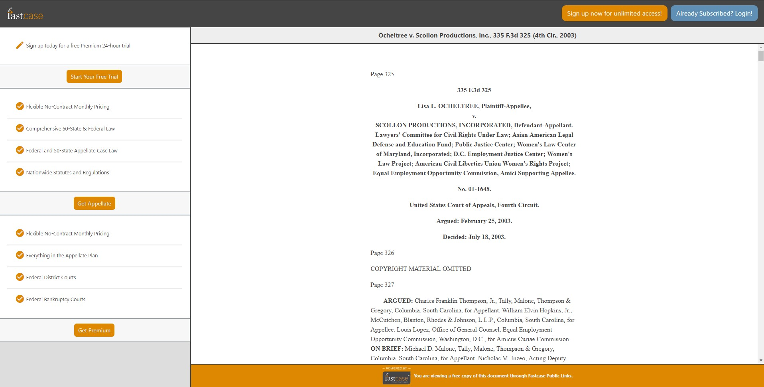
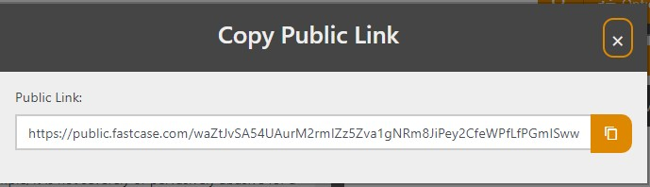
Public Link
Notes:
Public link allows you to share a copy of the primary law document you are viewing with anyone. The recipient does not have to be logged in and does not have to have Fastcase access as the public link URL is a public domain.

Slide 16
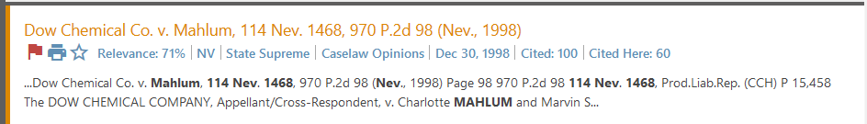
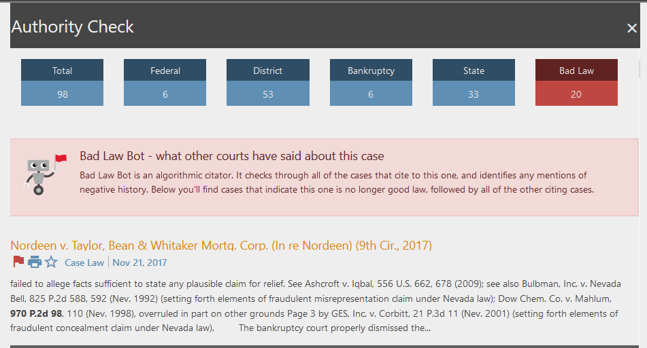

Bad Law Bot
Notes:
Negative treatment of cases is flagged by a feature called “Bad law bot”. If there is a red flag in the search results or at the top of a case, that means that the case has negative treatment in subsequent decisions, as noted by bluebook citation rules. If you click on the red flag, it will take you to the authority check report, which will display the negative interpretation of this case, so you can evaluate if the case is still useful or not.

Slide 17
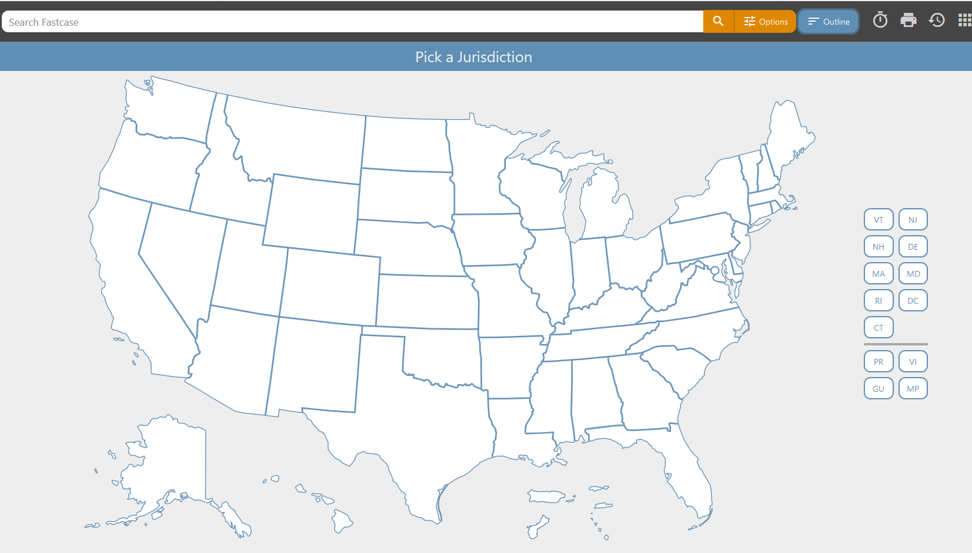
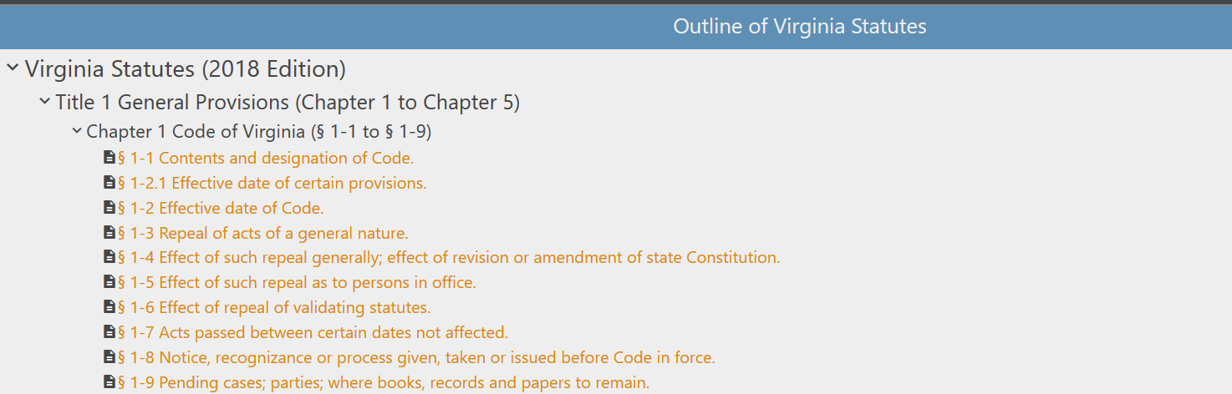
Document Browse
Notes:
Once on the index page, you can navigate through the entire statute. Simply select Outline from the top of the page, select a jurisdiction, then a document, then click on the arrows to navigate that document.

Slide 18
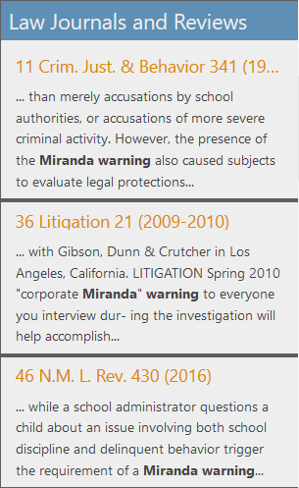
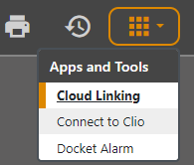
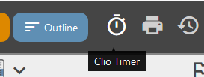
Partners with Hein, Clio, and More
CLIO
Hein Online
Access law review articles and bar journals in Fastcase with Hein Online
Connect your Fastcase account with your Clio account
Notes:
CLIO is a well known practice management software that facilitates billing and case management. If the user wants, they can connect their Fastcase account with a CLIO account. This allows the user to time their research in Fastcase, which allows the user to automatically generate bills for legal research. Additionally, the user can download documents directly into the case management for the specific case in process for organizational purposes.
Fastcase also has a partnership with Hein Online, the largest provider of secondary legal research materials: journals, bar reviews, etc. A user can use Fastcase’s legal research tools to search Hein content and read brief descriptions of the content, prior to making a decision to purchase the content from Hein Online.

Slide 19
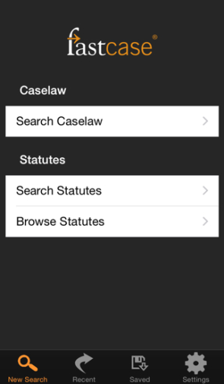
Mobile Fastcase
Fastcase offers a free mobile app, available for everyone to use anywhere.
Make a free account today and use for the rest of your career.
Notes:
The mobile app is free for download for iPhone or Android. Can be synchronized with your desktop account, which allows the user to search on their mobile phone, then access their results later on their desktop and vice-versa. See instructions for syncing at http://www.fastcase.com/mobile-sync/.

