Slide 1
The Docket Sheet
A Docket Research Primer for the Modern Attorney
Featuring Docket Alarm
Presented by the Fastcase Outreach Team

Slide 2
Housekeeping
“You clean the house before one may enter it.”

Slide 3
Today’s Agenda
What is a Docket?
Where Do We Do Docket Research?
How Do We Search Dockets?
Understanding Docket Sheets
Keeping Current with Docket Sheet Changes
Time Permitting: Analytics and Integrations for Docket Sheets
Wrap-Up and Q & A

Slide 4
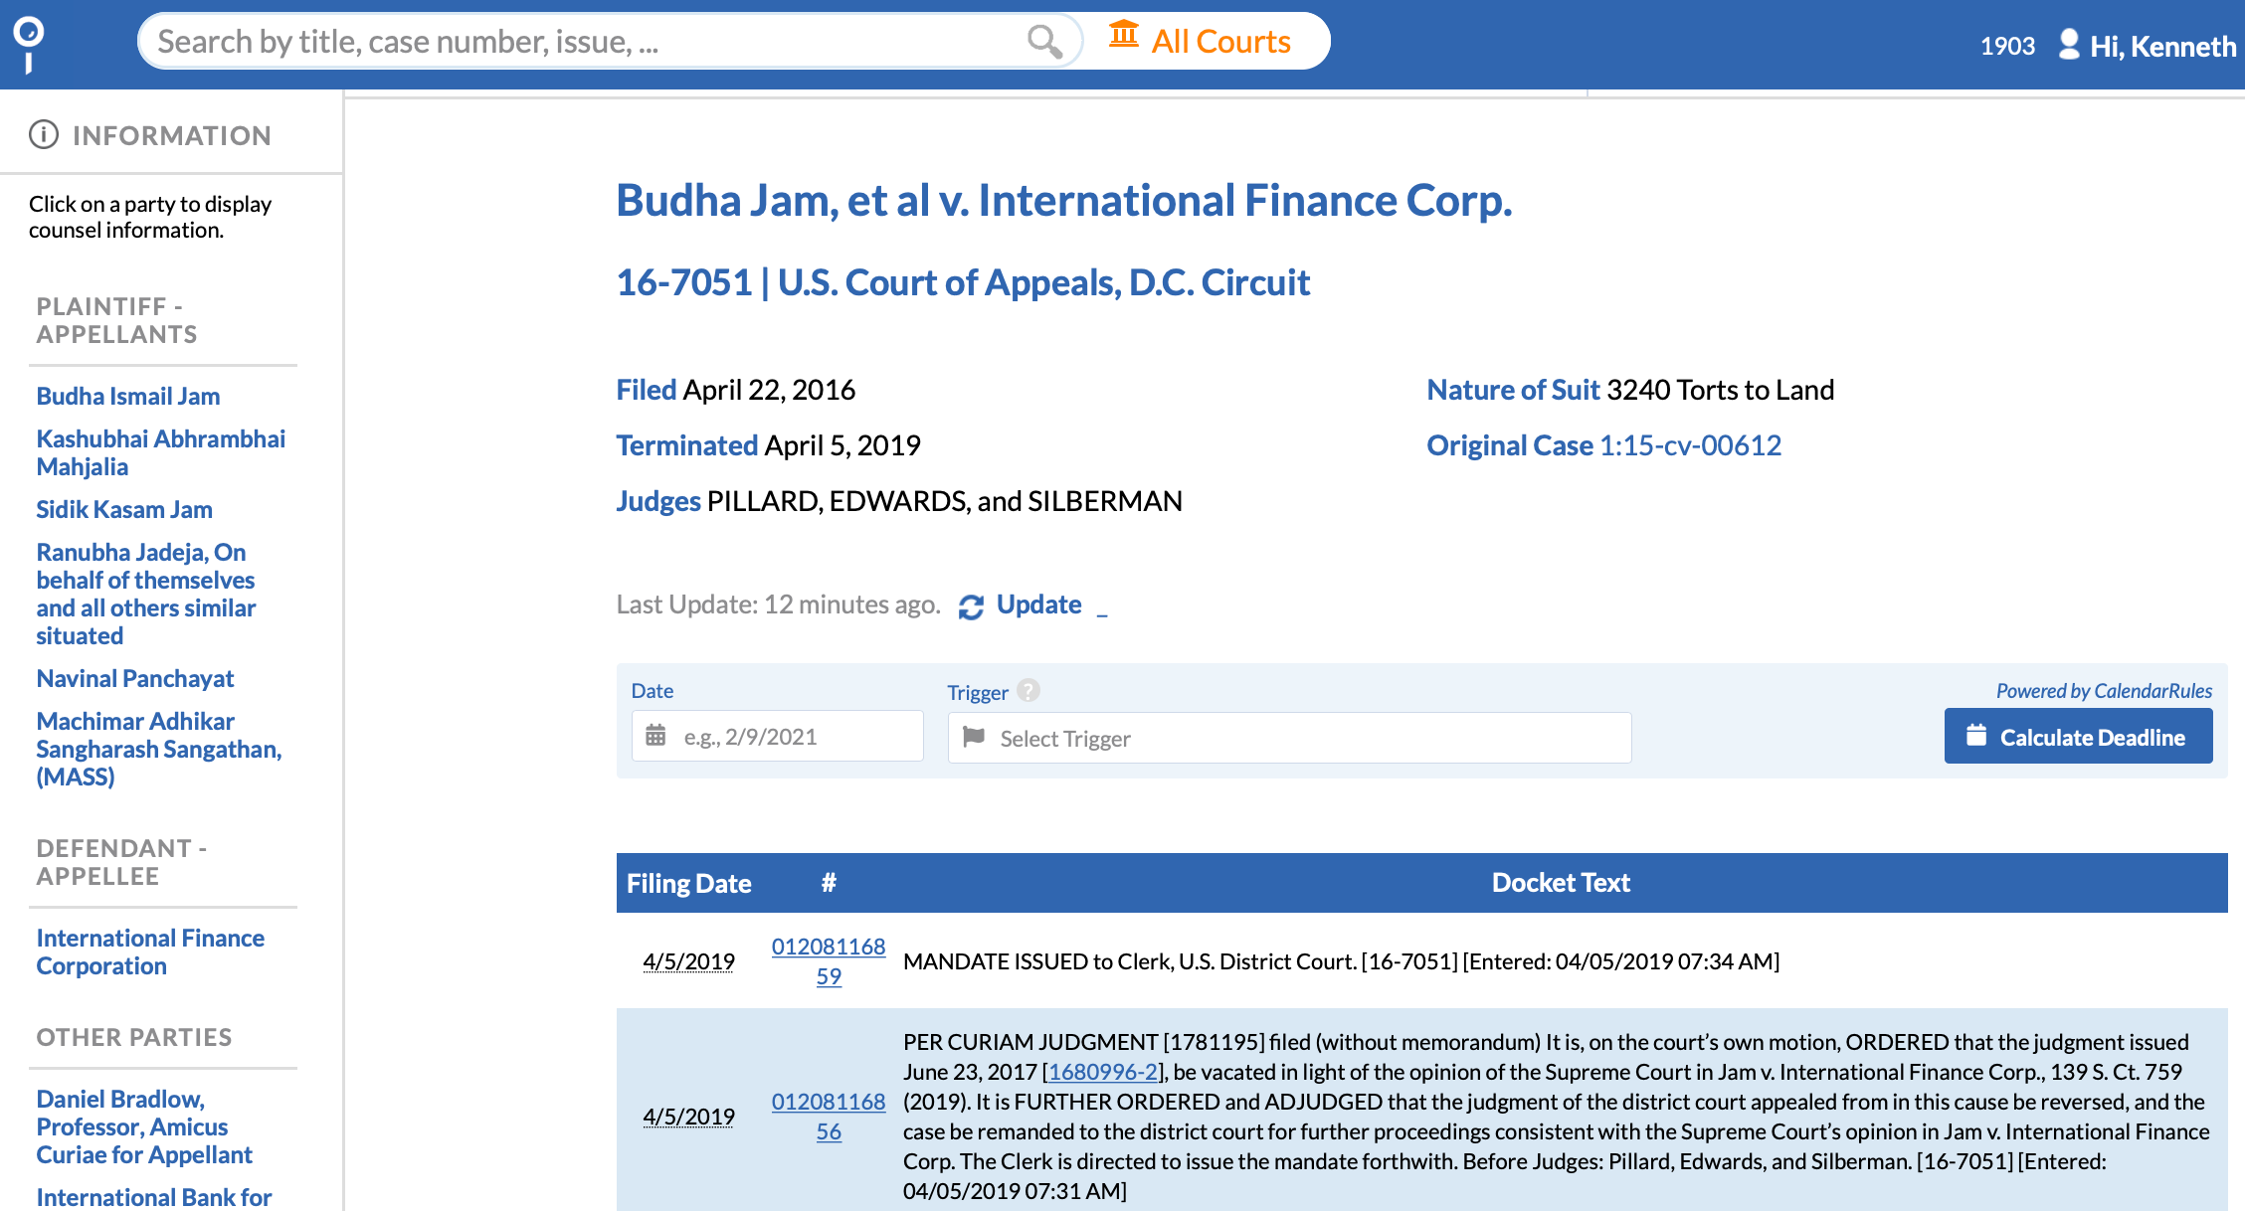
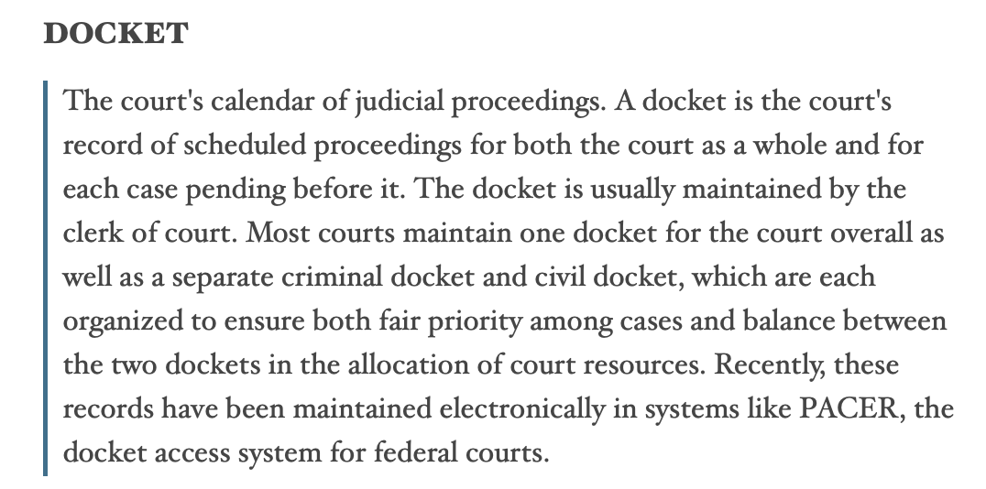
What is a Docket?

Slide 5
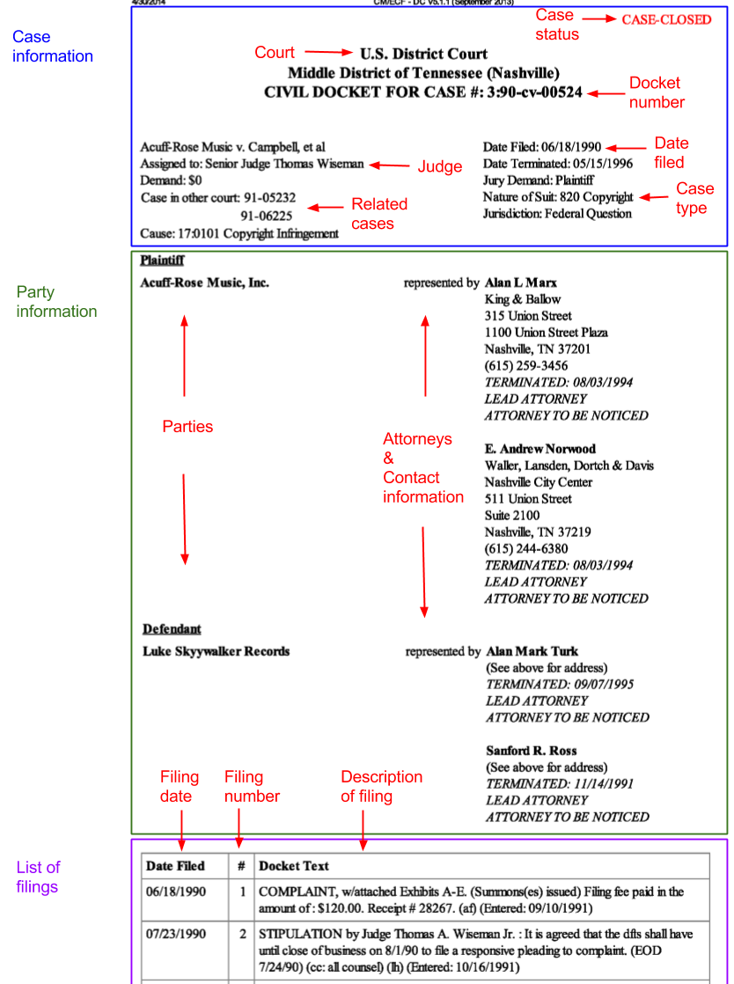
Parts of a Docket
Appearance Docket
Docket Number
Court
Docket Entries with Filing Date & Number
Underlying Documents
NOS Codes
Associated Cases
Date Case Commenced and (when applicable) Terminated

Slide 6
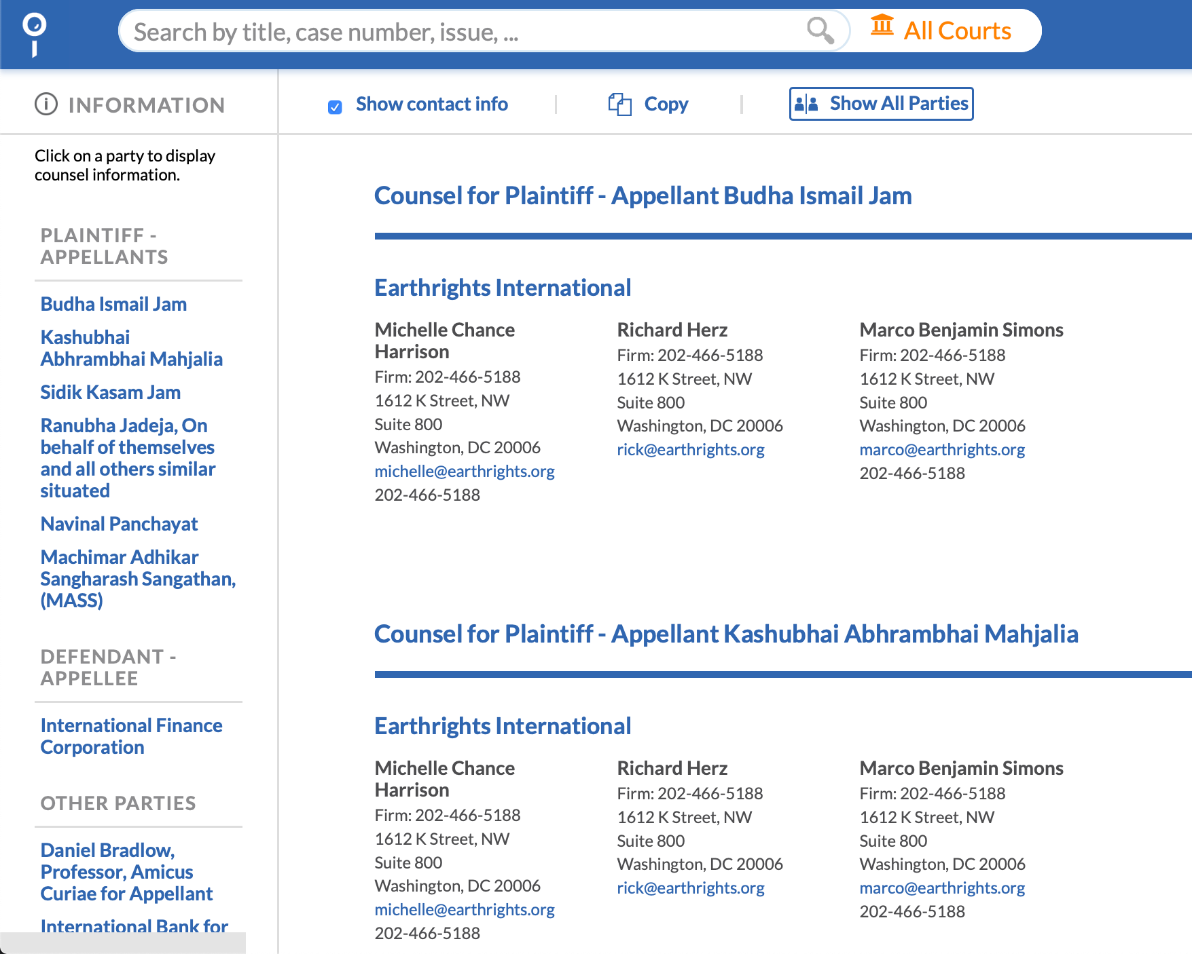
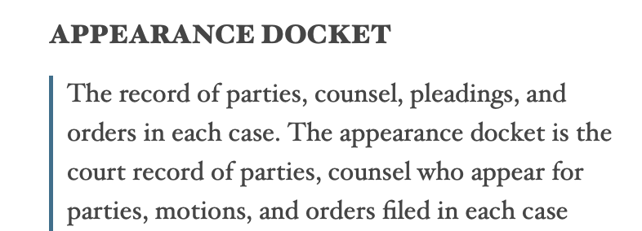
What is the Appearance Docket?
“It is just a fancy way of saying, who are the parties and lawyers in the case.”

Slide 7
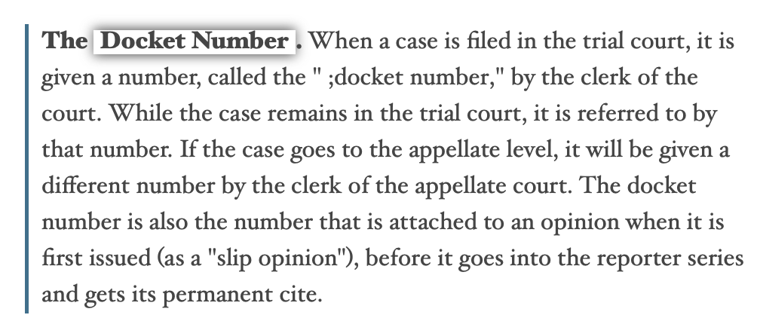
What is a Docket Number?

Slide 8
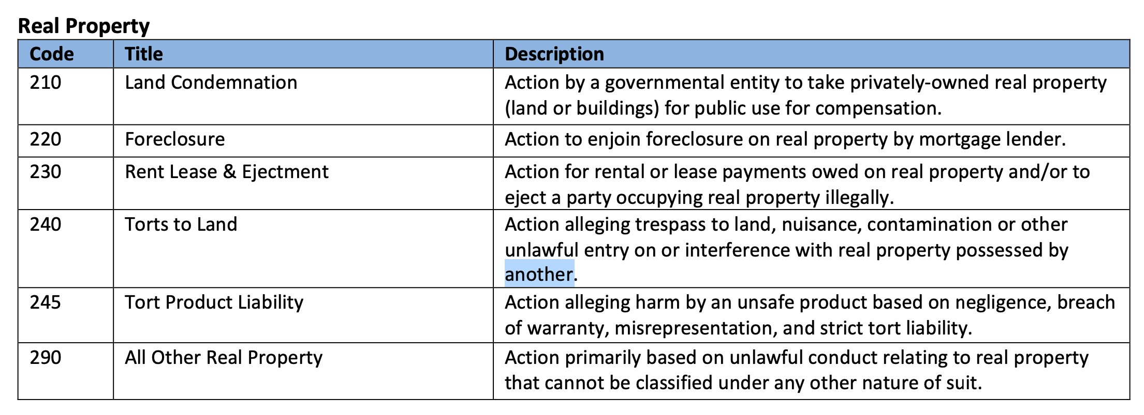
What are NOS Codes?
Find all descriptions here:
https://www.uscourts.gov/sites/default/files/js_044_code_descriptions.pdf

Slide 9
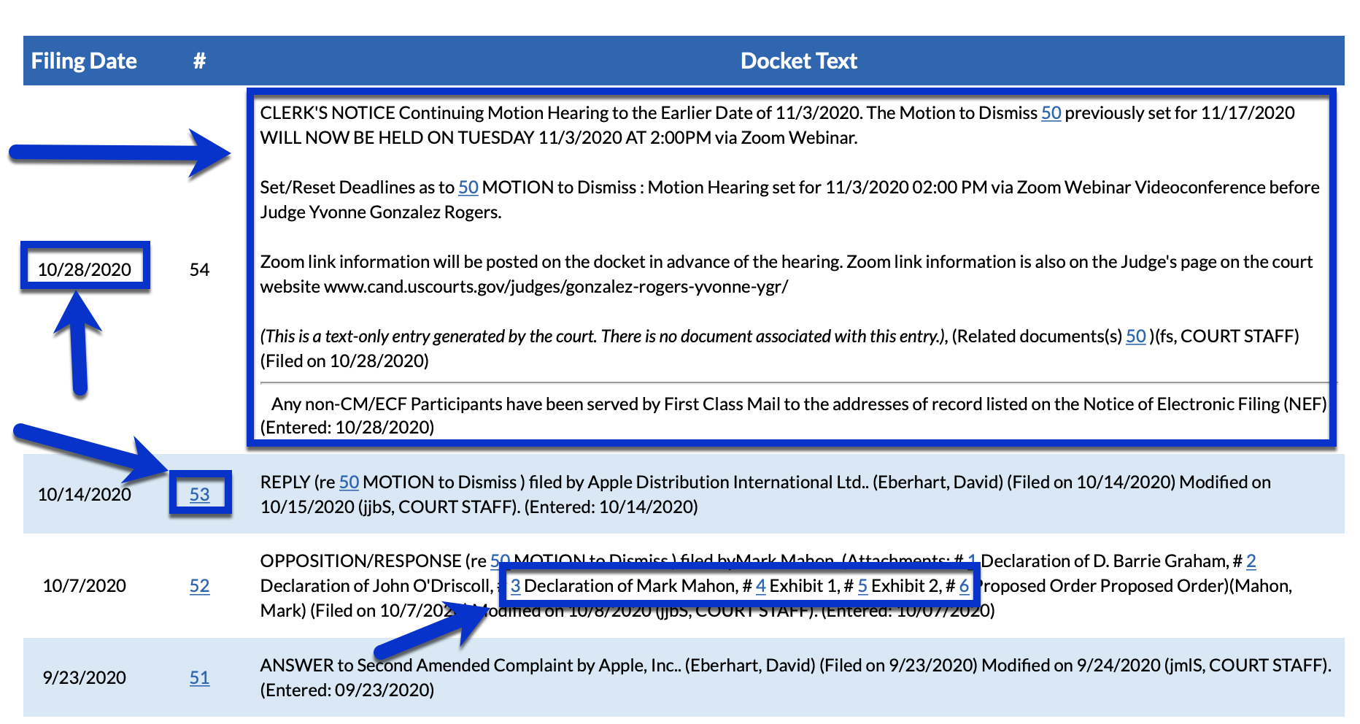
Docket Entries
A docket entry is referred to simultaneously as a filing. A docket entry is represented by:
Entry/Filing Date: Marks when the court clerk officially recognized the filing on the docket sheet.
Entry/Filing Number: Marks order of actions in the litigation. In most repositories, the filing number is hyperlinked, where upon clicking the underlying filing/entry documents open for viewing and/or downloading.
Description of the filing/entry: This typically includes hyperlinks to the attachments associated with any given filing.

Slide 10
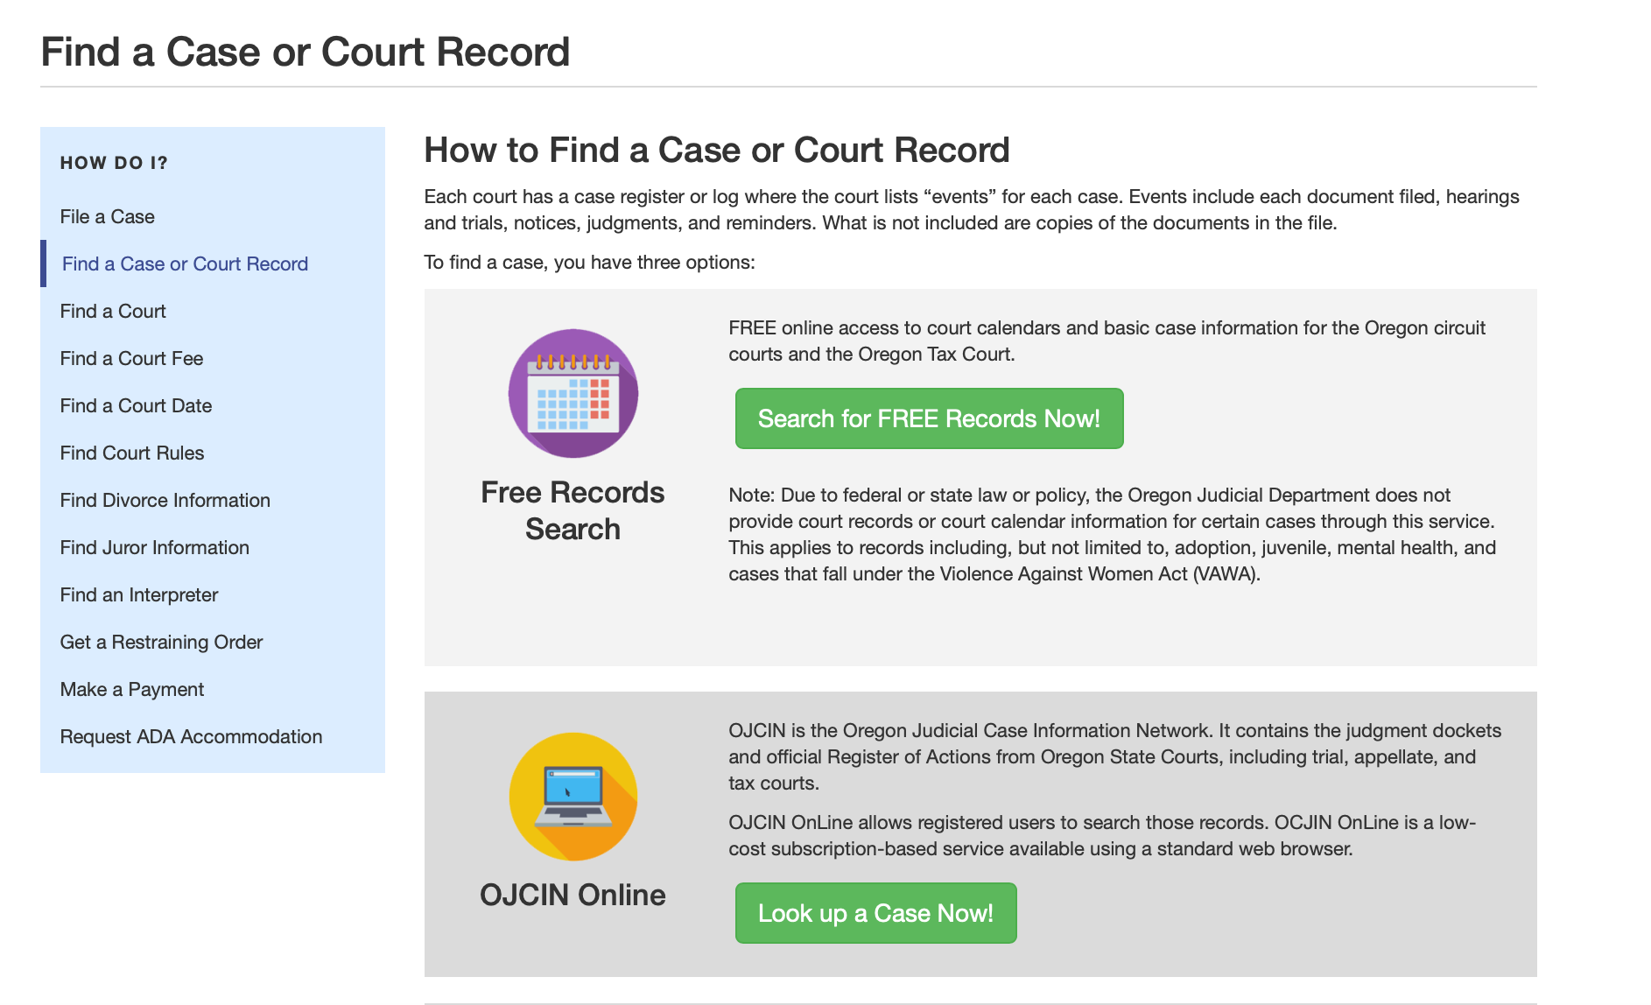
Where Do We Find Dockets?
Federal Dockets
PACER
Commercial Repositories
Ex: Docket Alarm
State Dockets
No uniform public location like PACER. Available on a jurisdictional basis, but options may vary.
For example, in Portland, OR, one can access docket sheets for free, but must pay a price to access underlying documents, final orders, appearance docket, and calendar.
Commercial repositories.
Rarely provide dockets for family law matters.

Slide 11
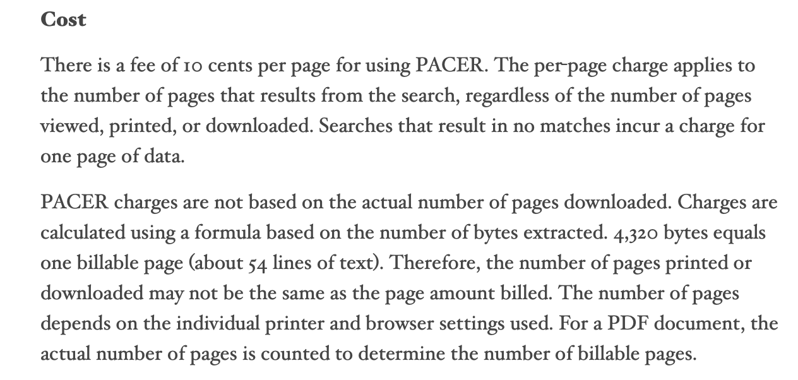
What is PACER?
“Public option for finding federal dockets.”

Slide 12
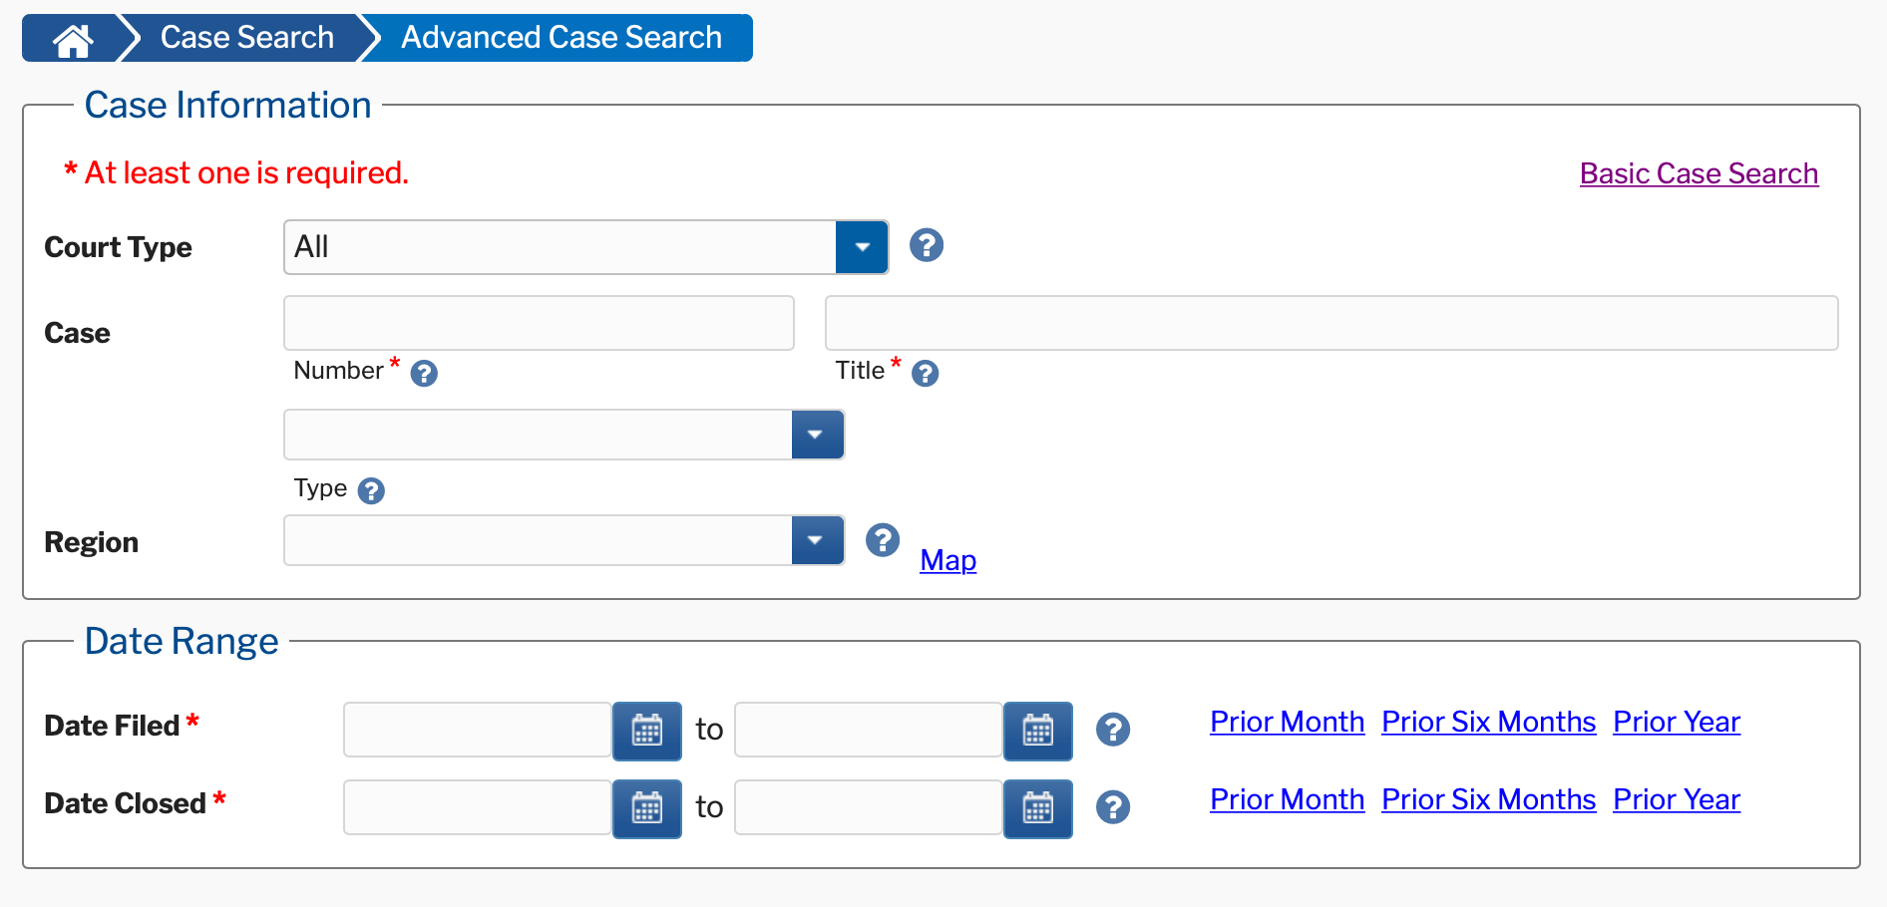
Issues with PACER
Difficult to use. Once called “as archaic as a barrister’s wig.”
Cannot conduct a search within the body of the docket.
Searches limited to filing/termination date, party name(s), docket title, or docket number.
Pay per search, even if no results are returned.
Not all courts use PACER.

Slide 13
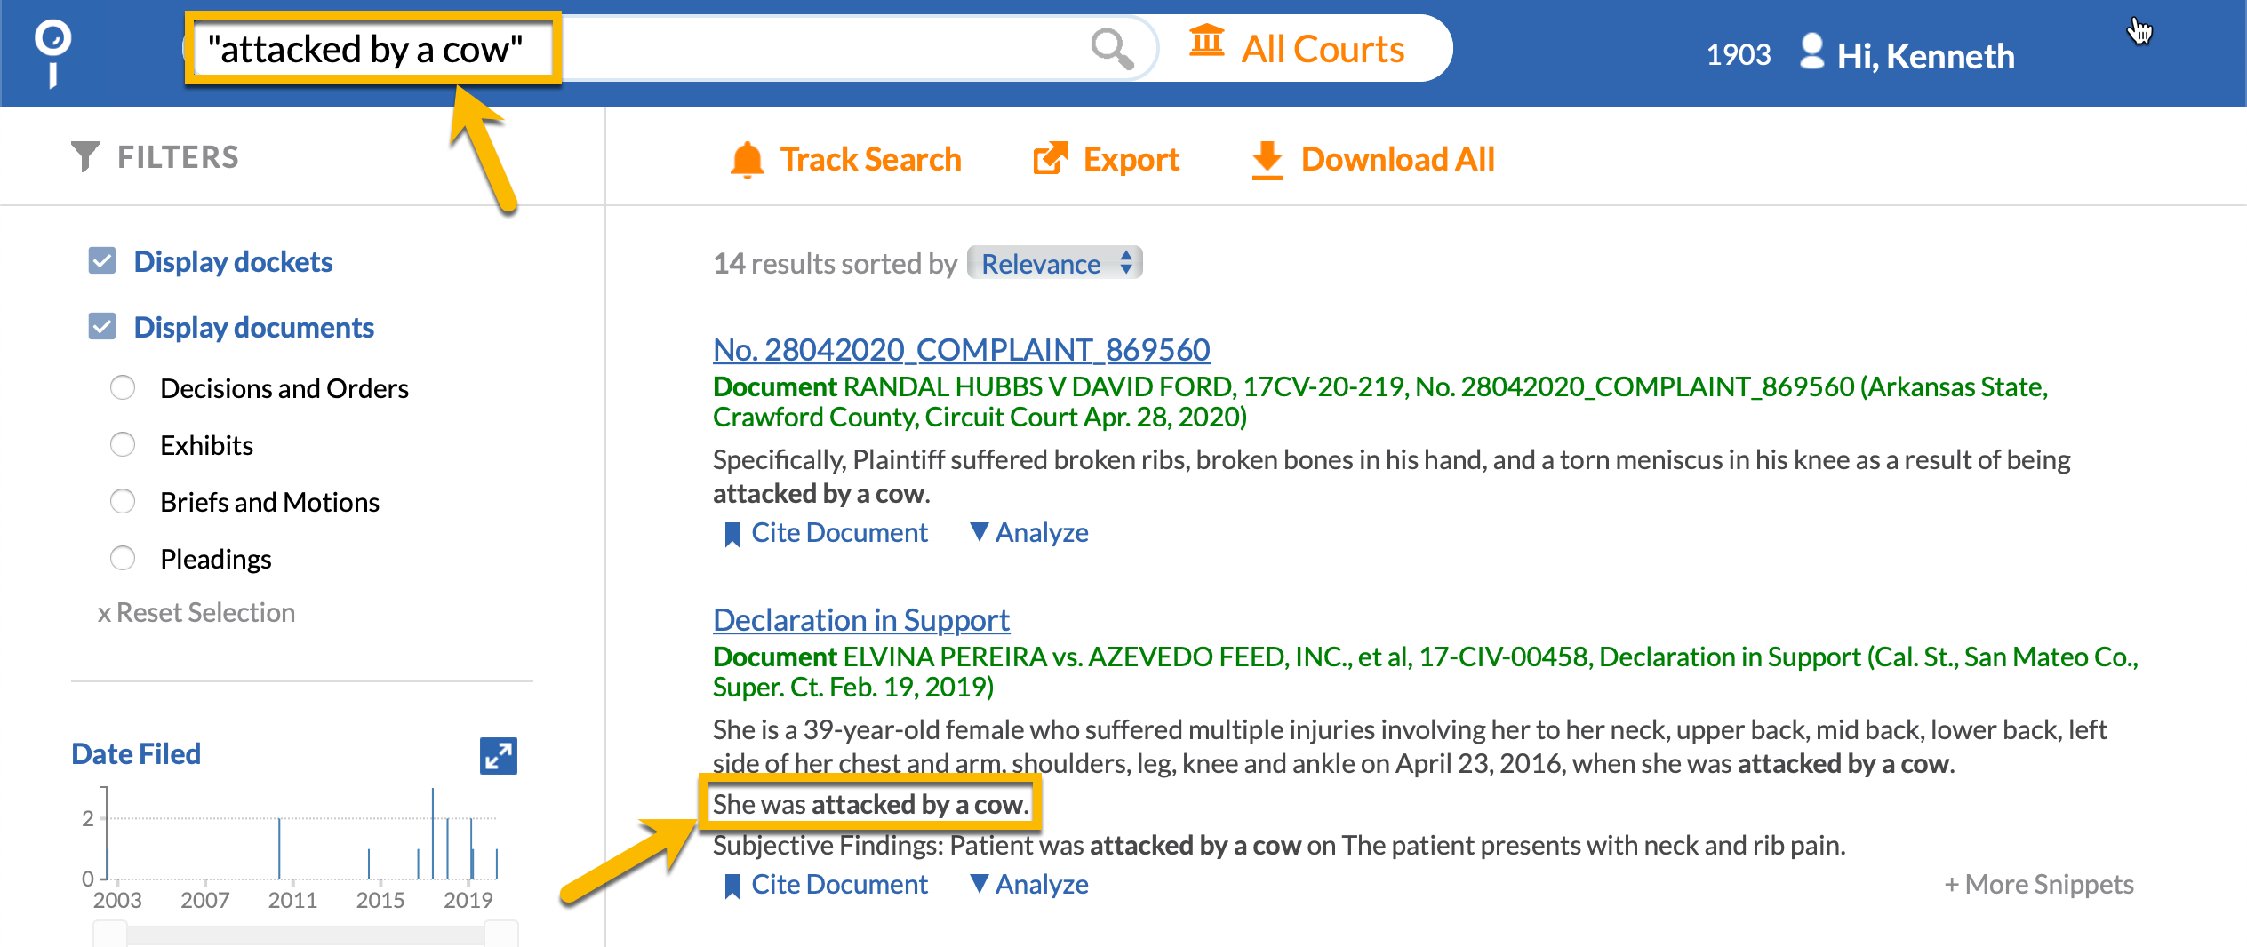
Searching Dockets
Natural language search refers to typing in a grouping of words in order to locate a docket or docket document.
Natural language search looks for all designated words within the docket sheet, using what is referred to as an “implied and.”
A natural language search will pull up documents containing all words without a requirement that the words be near each other. Use quotes “” around the natural language search to ensure the docket contains designated words in your natural language search side by side with no words in between.
Natural Language

Slide 14
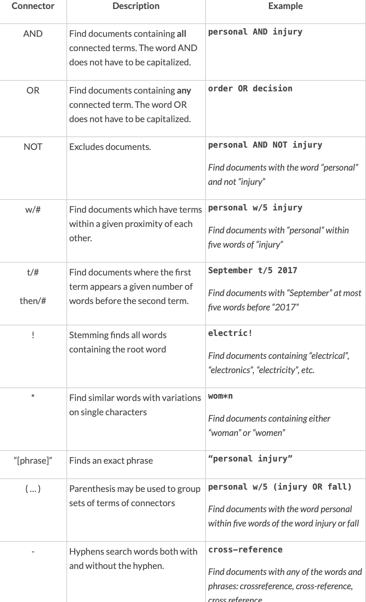
Searching Dockets
Boolean Operators
Searching for Dockets using boolean operators means that you designate keywords you want the docket to contain, however, you also used recognized “operators” to designate relationships between those keywords.
Check with your specific repository about the boolean operators it utilizes, as these can vary repository by repository. These are for Docket Alarm.

Slide 15
Narrow Results Using Filters
Commercial repositories allow you to use filters for a wide range of criterion, including judge, cause of action, firm, nature of suit codes, filing date, termination date, court, case type, document title, and even whether or not a docket has accurate information present in the appearance docket.
PACER only allows filtering by court, filing date, termination date, NOS code, and party.

Slide 16
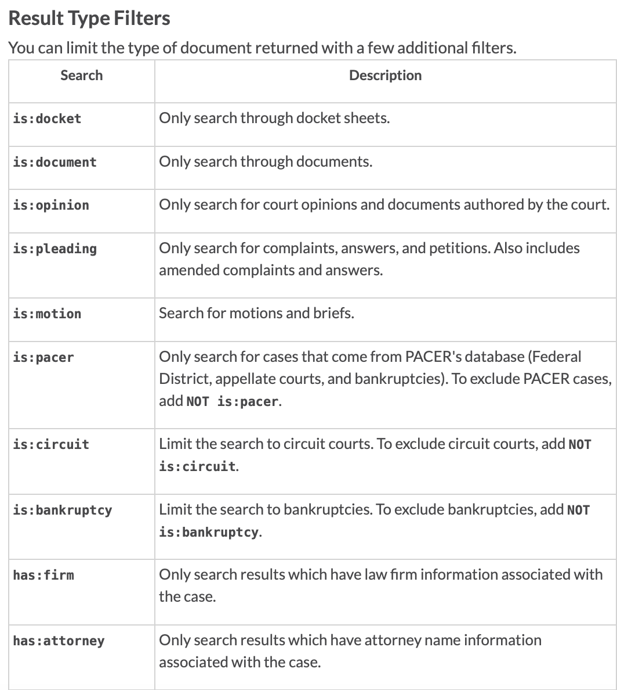
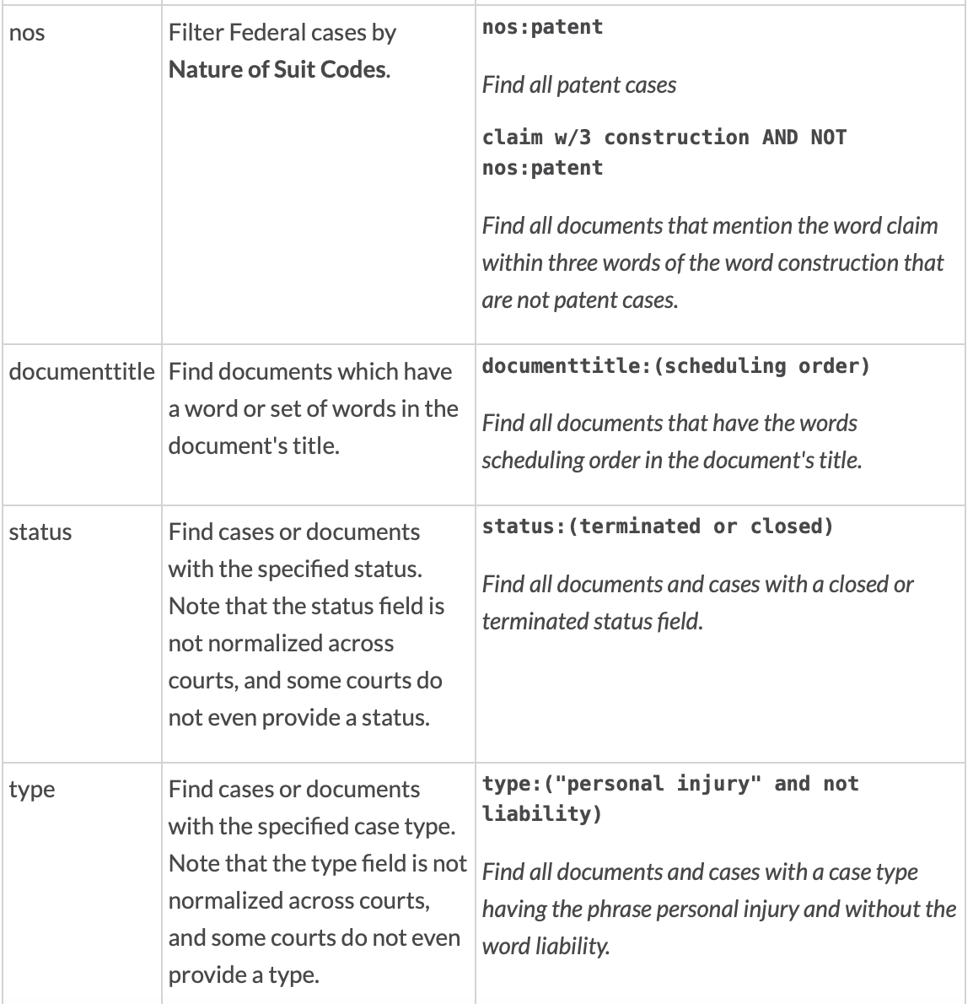
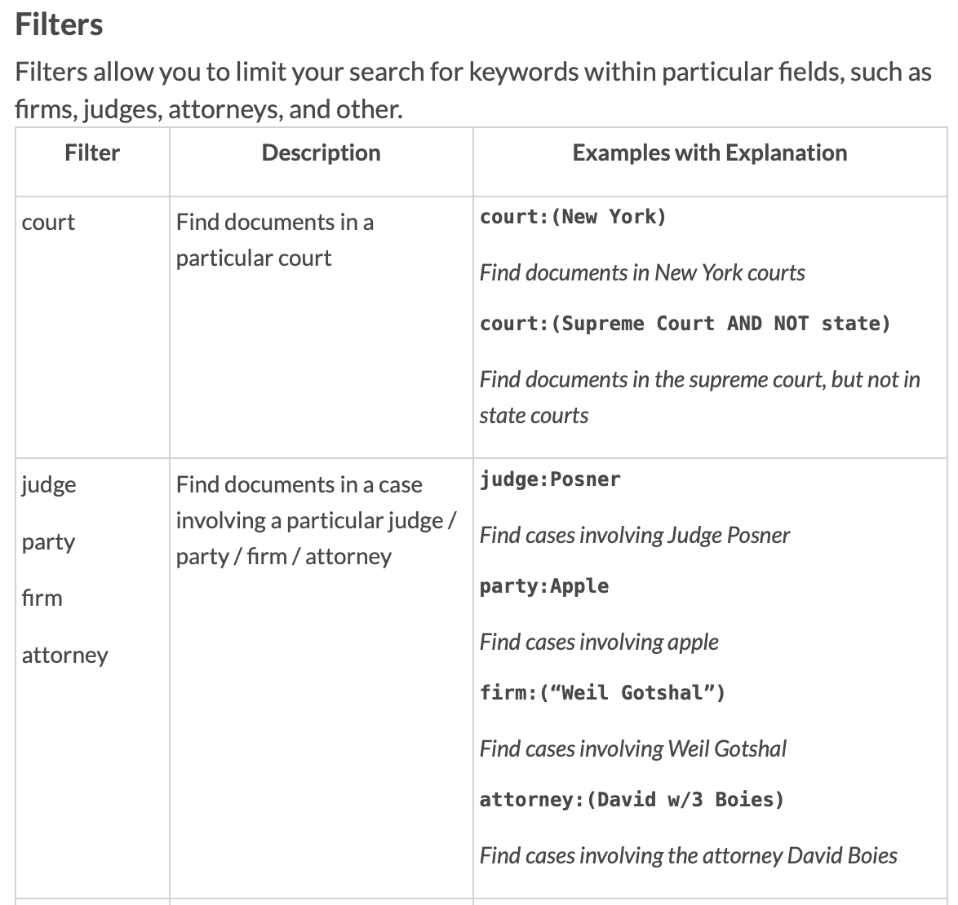
Common Filters

Slide 17
Time to Demo: Search Types and Application of Filters
Reminders
PACER does not possess expansive filters, however, commercial repositories (Docket Alarm, CourtLink, Docketbird etc.) all possess variations of the filters demoed.
PACER and most state-maintained docket repositories do not allow for natural language OR boolean operator searches. Searches are limited to specific parts of the docket, e.g. party name, court, docket number, filing date, termination date.

Slide 18
Advanced Search/Query Builders

Slide 19
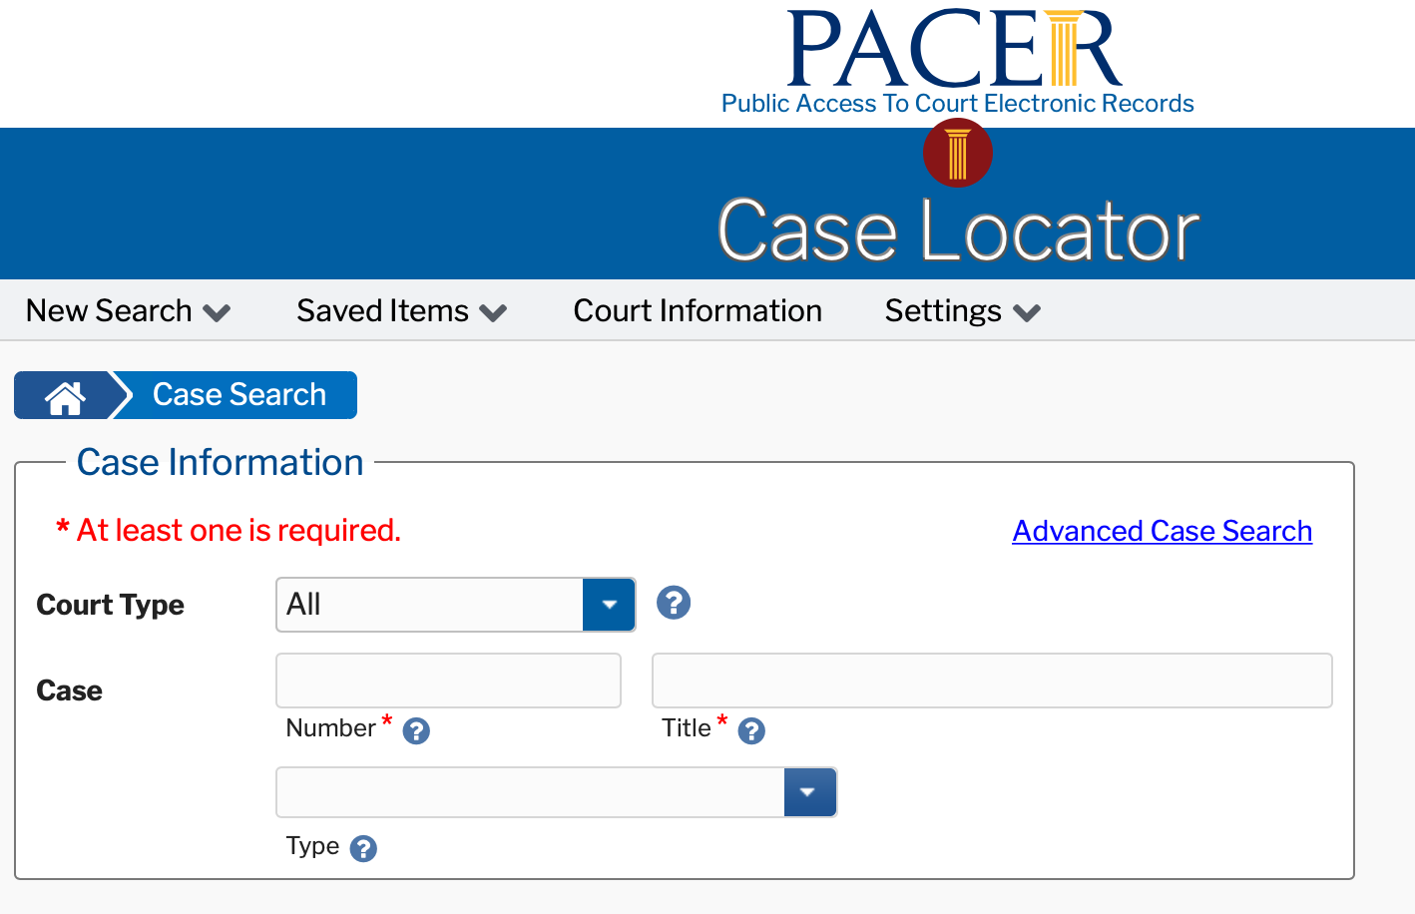
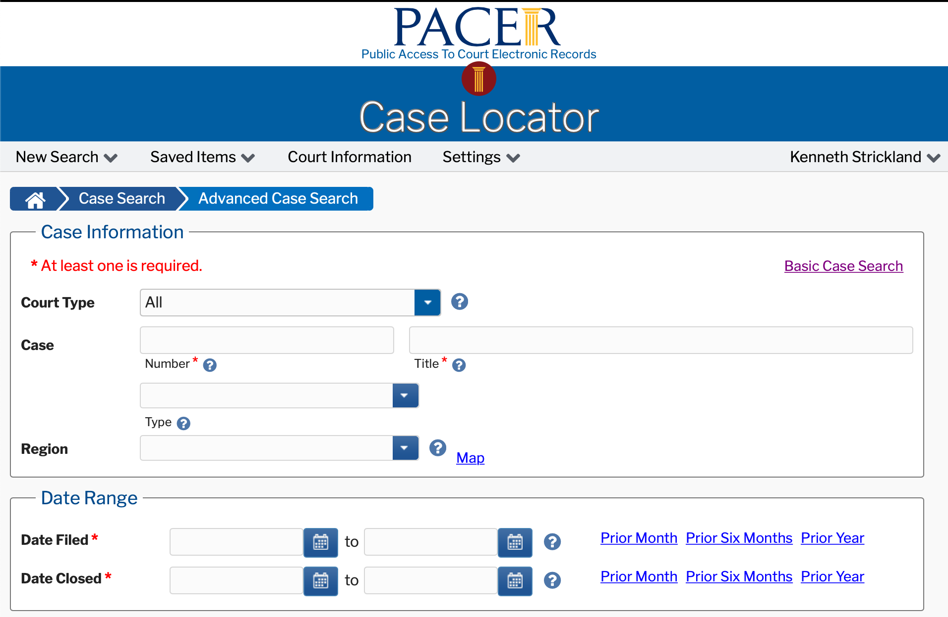
PACER Lacks True Advanced Search Capability, With Advanced Search Simply Adding Filters for Date Range and Region

Slide 20
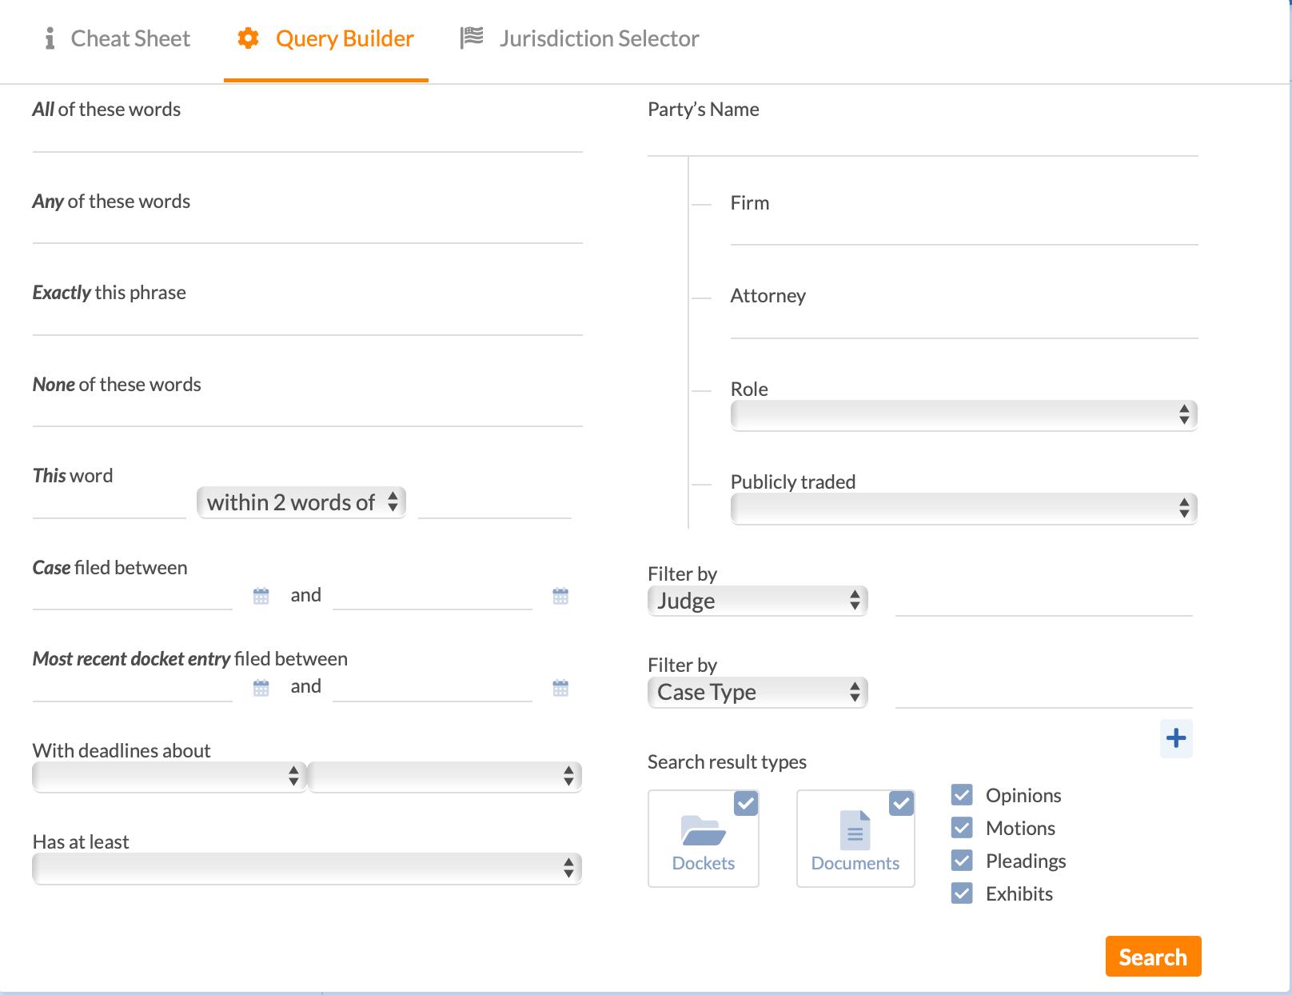
Live Demo: Query Builder/Advanced Search in Commercial Repository

Slide 21
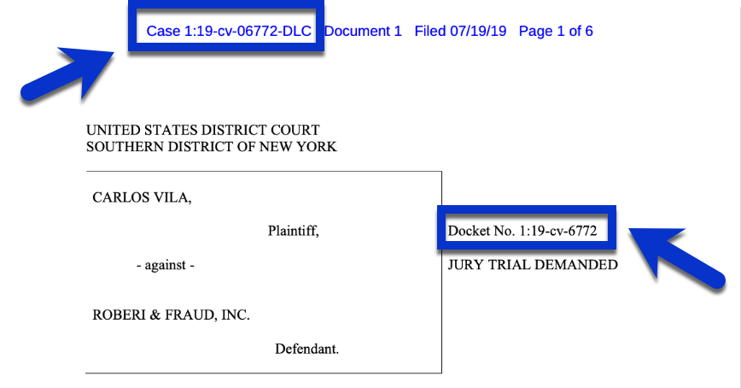
Searching by Docket Number
You can search in PACER and commercial repositories using the Docket Number.
Docket number and case number are the same thing, though the case number usually includes the judge/magistrates initials at the end.
You need not include the judge’s initials when doing a docket number search.
When a document is electronically filed, as with filings in federal dockets, the case number is at the top, with the docket number to the right center of the cover page of the filing.

Slide 22
Format of Docket Number
Year e.g. 2019
1:19-cv-06772-DLC
Filed Case No. 6772 in 2019
Filing location.
Judge’s Initials
CV: Civil Action
CR: Criminal Case

Slide 23
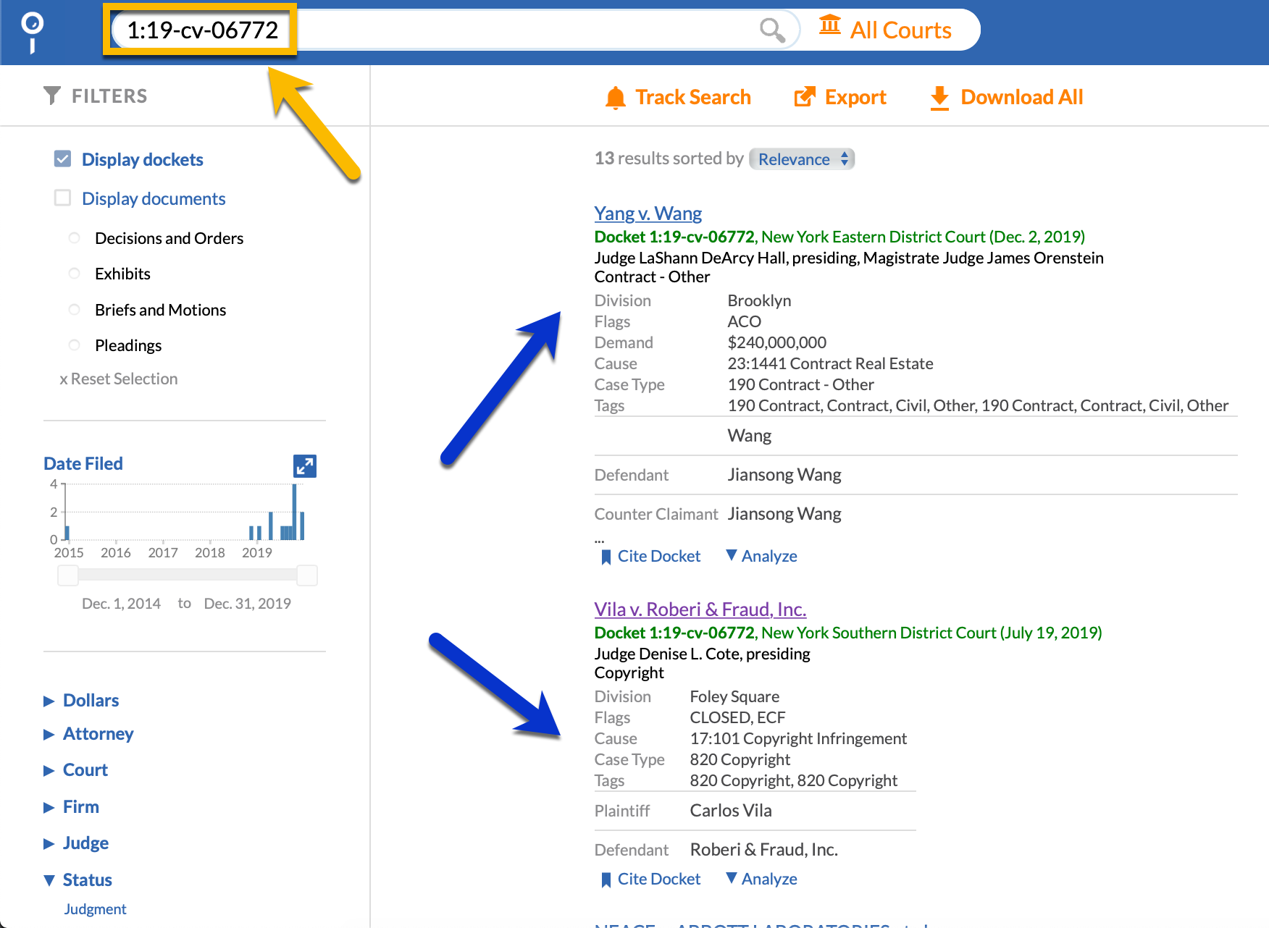
How to Search Docket Via Docket Number
Enter the entire docket number, minus the assigned judge’s initials.
For the previous slide, this means search using 1:19-cv-06772
Tip: Narrow your search by court first, as multiple courts follow the same numbering model for dockets.

Slide 24
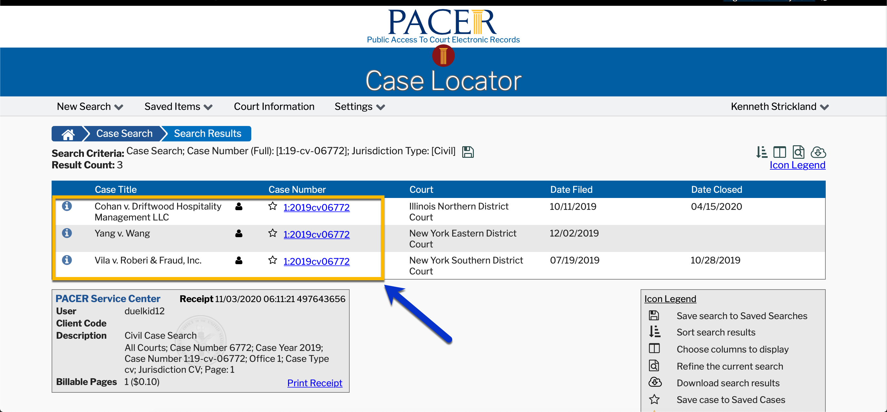
If using PACER, you must know the party names in addition to the docket number, as the national index has no court filter like commercial repositories.
“Who did I sue again?”

Slide 25
Locating Docket Documents

Slide 26
Option One: PACER
1. Locate the docket sheet of your choosing.
2. Click the case number to open.
3. Select “History/Documents.”

Slide 27
4. Choose Options. Select “Run Query.”

Slide 28
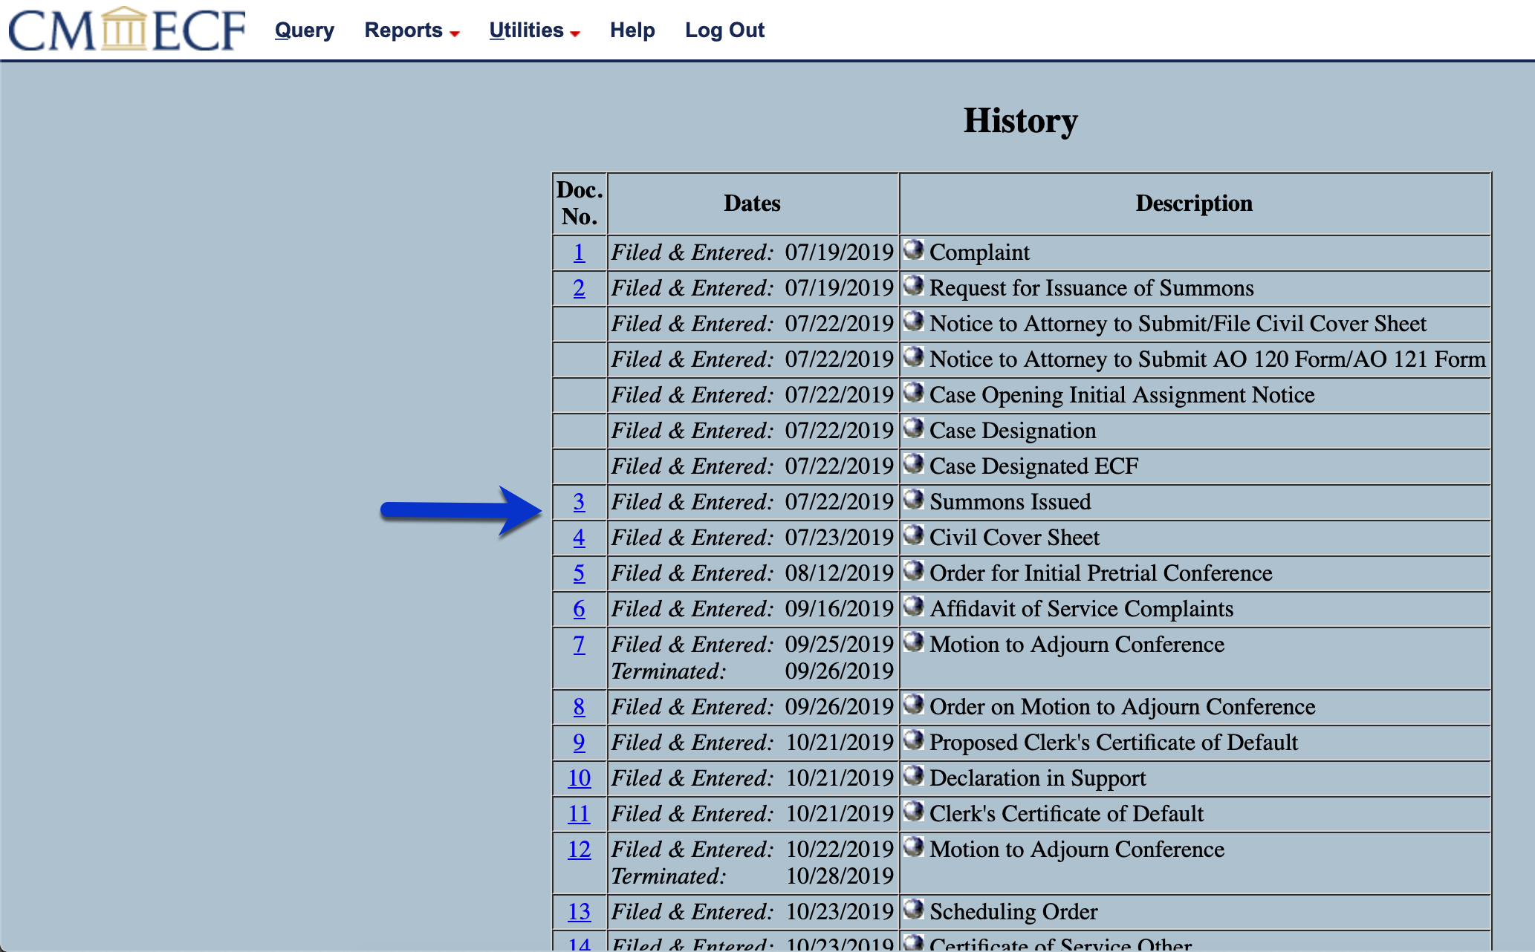
5. Select the hyperlinked number next to desired document.

Slide 29
6. Choose to view or download desired documents.
Note: PACER does not allow you to download the filing without the attachments.

Slide 30
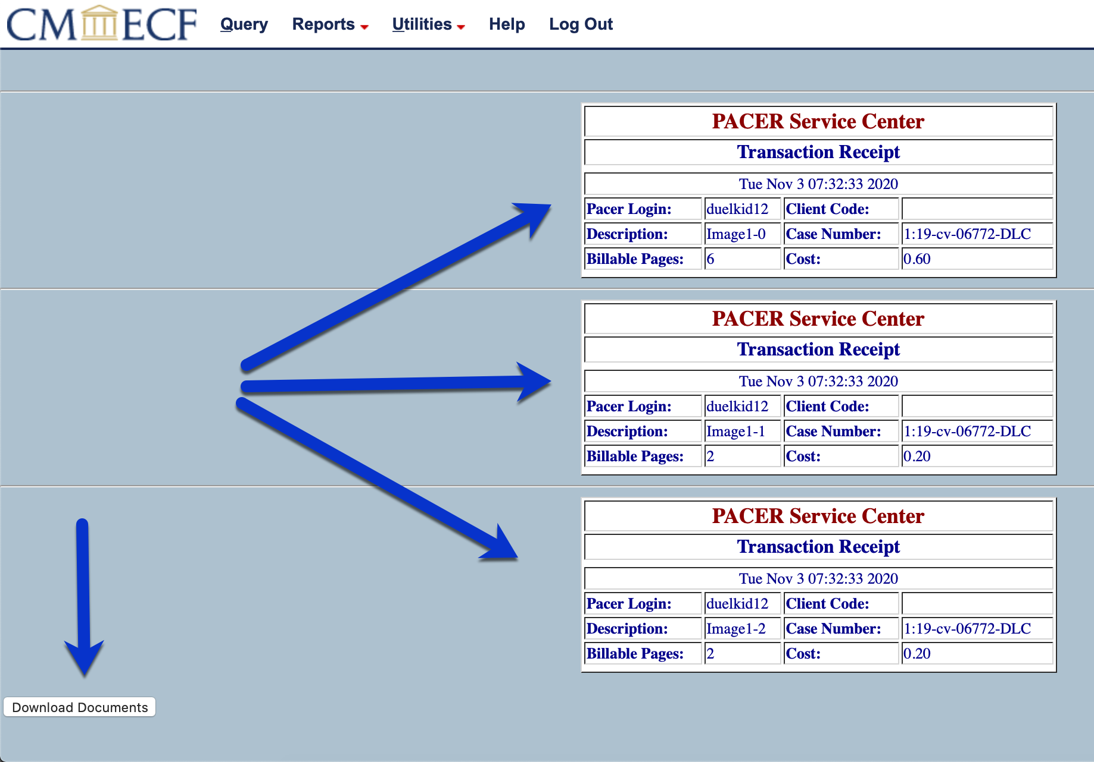
7. Review the charges and select “download documents.”

Slide 31
Option 2: Commercial Repository

Slide 32
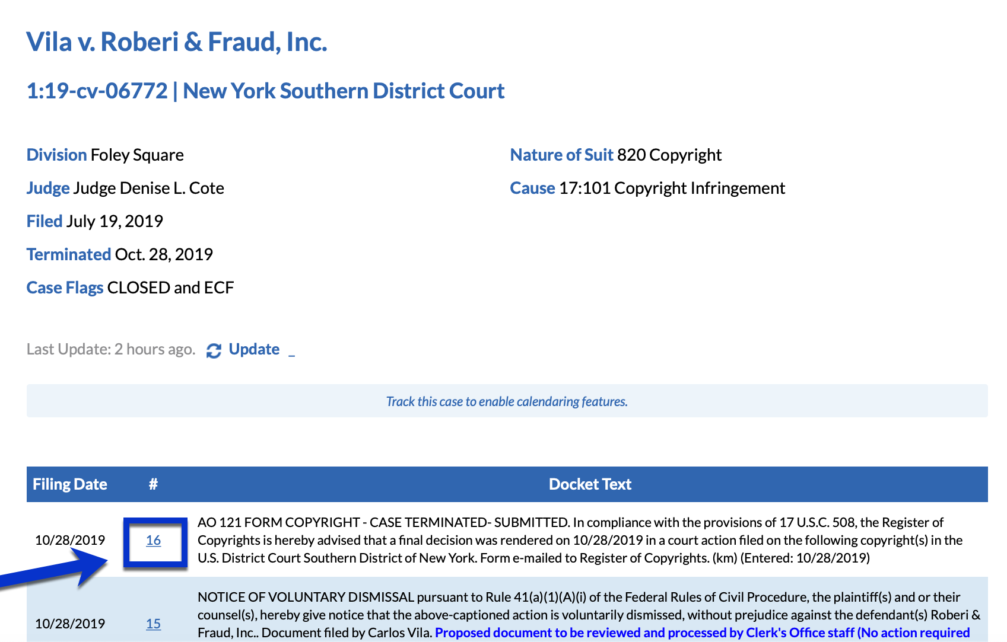
Step One: Locate and Open the Docket Sheet.
Click the hyperlinked number beside the docket document to open document plus attachments.

Slide 33
Step 2: Select hyperlinked attachments within description of docket entry to download attachments without the original filing.

Slide 34
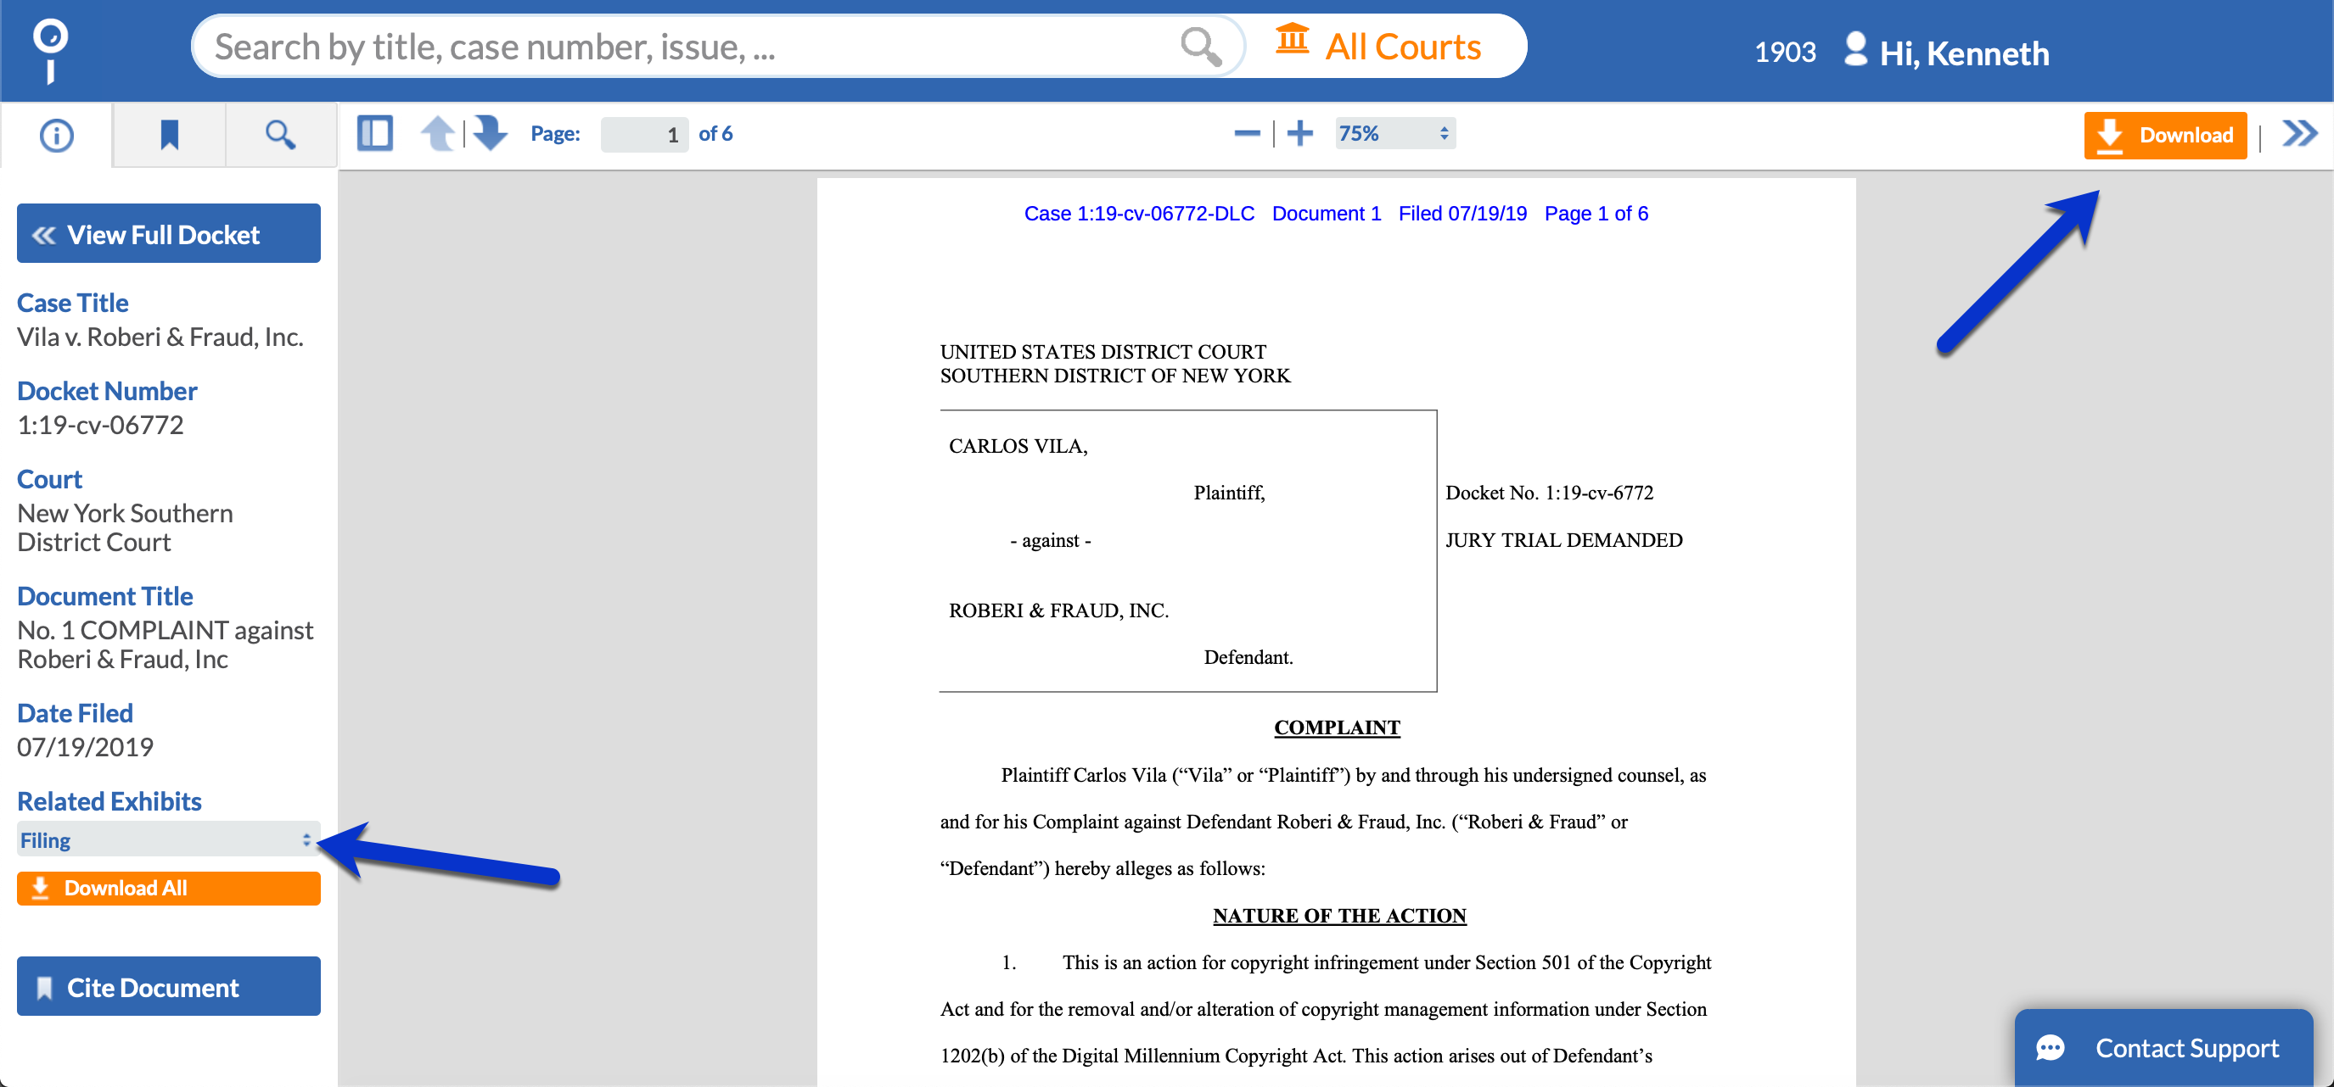
Step 3: Once the document is open, download using the icon in the top right or view attachments using the drop down menu in the bottom left.

Slide 35
Staying Current with
Litigation Changes

Slide 36
Alerts
“Stay ‘Alert’ By Following Searches”

Slide 37
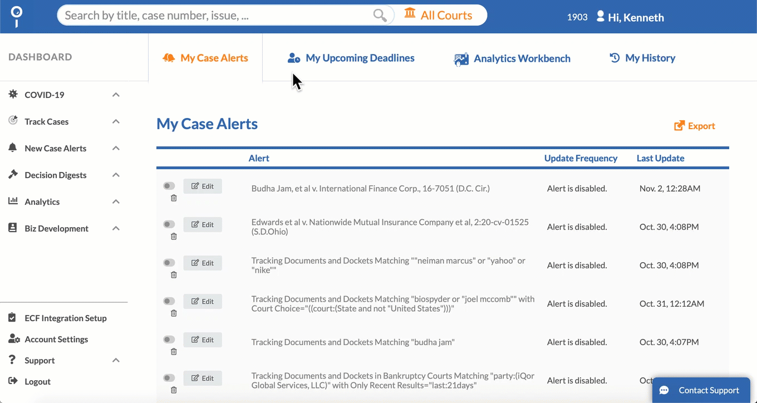
If you can search it, you can track it.
1. Using the query builder or manual searching, build your search.
2. Analyze your search results.
3. Click “Track Search” (aka “Create Alert”)
4. Choose desired settings.
5. Wait for those emails that do all the work keeping you apprised of new litigation or changes to existing litigation.

Slide 38
Staying Current on
Individual Dockets

Slide 39
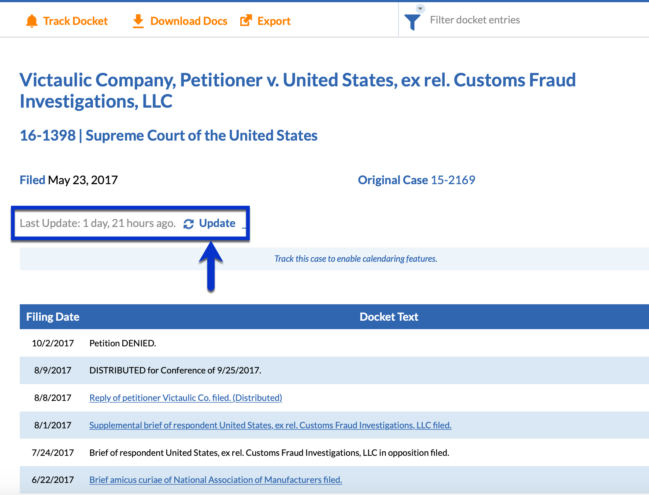
Option 1: Manually Update
PACER does not allow for a manual update option, but rather automatically updates dockets and then charges the user just for viewing any docket sheet and/or docket document.
In comparison, commercial repositories often give the user the ability to update a docket at will, thereby bypassing undesired charges by attempting to update an unneeded docket.

Slide 40
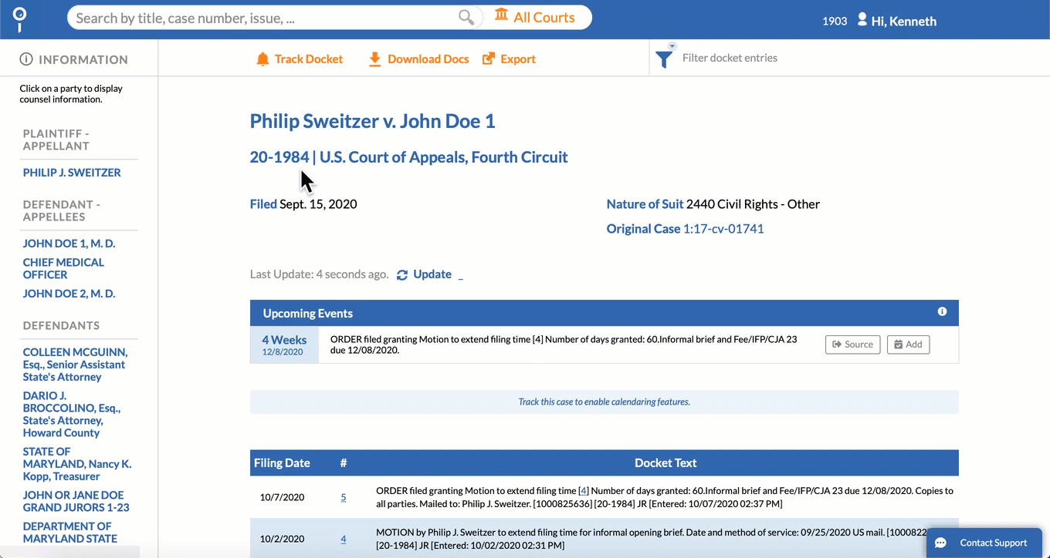
Option 2: Automatically Track Individual Dockets
PACER requires a user to search for and open a docket sheet each time that user desires to check for updates, with no confirmation that an opened docket will actually have updates.
Commercial repositories, like Docket Alarm, monitor all dockets in the courts and thus allow users to receive automatic updates without an additional fee and no additional searching.
With automated docket tracking on commercial repositories, you simply search for the docket once, click “track docket,” and go.

Slide 41
Live Demo: Docket Analytics
“Judge Deborah did WHAT now?” “Does that firm sue everybody?”
“Where is the court where I can win the easiest?”

Slide 42
Questions?
Email: support@docketalarm.com
Phone: (866) 773-1782, Option 4
Chat: Use Tab in Bottom Right of Application
Monday-Friday
8 am - 9 pm EST

